Slide 1
Respiration in the Mesopelagic Ocean (ReMO):
Reconciling ecological, biogeochemical and model estimates
SCOR Working Group 161
Co-Chairs : Carol Robinson, Javier Arístegui, Iris Kriest

Slide 2
Aim & deliverables
What controls remineralisation in the water column – reconciling ecological, biogeochemical and model estimates - & thus the efficiency of the biological carbon pump
What governs mesopelagic respiration ?
temperature, pressure, oxygen, CO₂, inorganic nutrients and the composition, sinking rate & lability of organic material
Who is doing the respiring ? microbes / metazoa
Prioritise the knowledge gaps / uncertainties methods / models
What can be learnt from new technologies ? BGC-Argo, gliders, proxies etc.
Database, method intercomparison, best practice manual, develop capacity

Slide 3
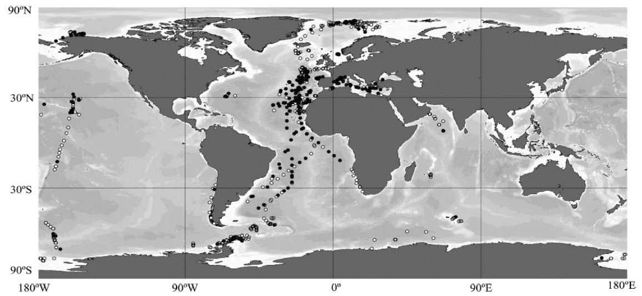
Progress on deliverables
Data compilation
n = ~3000
Regaudie de Gioux & Duarte, 2013
Collate a global database of oceanic respiration & make it accessible to and easily useable by climate modellers
Contribute to the ReMO international training course on observations and models of deep-water respiration

Slide 4
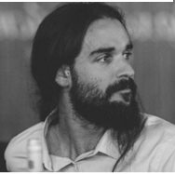
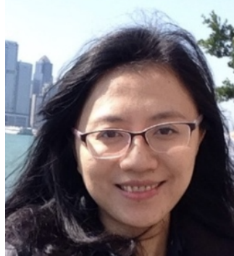
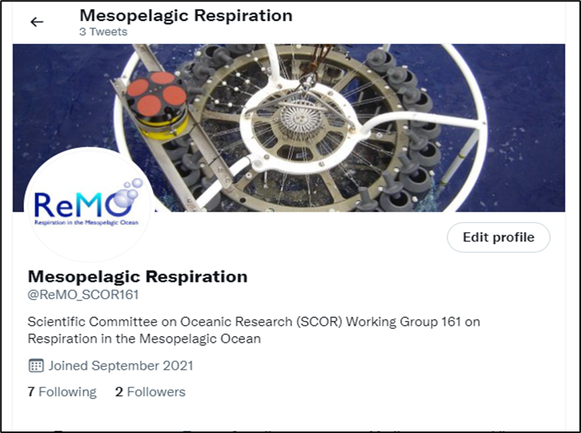
Progress on deliverables
Mentoring scheme
Dr. Jordan Toullec, Laboratory of Oceanology and Geosciences, Wimereux, France
Mentor: Natalia Osma (Chile)
Dr. Yi Xu, East China Normal University, Shanghai, China
Mentor: Sara Ferrón (USA)
Dr. Saumya Silori, CSIR- National Institute of Oceanography, Visakhapatnam, India
Mentor: ‪X. Antón Álvarez-Salgado (Spain)
Dr. Josué Rodolfo Villegas Mendoza Universidad Autónoma de Baja California (UABC), Ensenada, México
Mentors: Natalia Osma (Chile) & Carol Robinson (UK)
Seminar series, website & twitter account

Slide 5
Progress on deliverables
Terms of Reference / Deliverable | Due end | Progress
Identify, quantify and prioritise gaps in our knowledge, and prepare an action plan to reduce these gaps by reviewing available information on mesopelagic respiration
D1. An action plan to identify gaps in knowledge and propose ways to address those gaps | 2021
D2. A position paper, based on the plan, highlighting the importance of reliable estimates of mesopelagic respiration, and suggesting priority research questions | 2021 | X 2
D3. A model intercomparison / data sensitivity paper | 2022
Develop a global dataset of mesopelagic respiration estimates, derived from the range of ecological and biogeochemical techniques available, in order to create a resource for validation of biogeochemical models including Earth System Models used for climate projection
D4. A global dataset, linked to international marine data hubs, for use by modellers, launched at a Town Hall meeting at an international conference such as Ocean Sciences | 2023 | +
D5. A data paper in Earth System Science Data | 2023
Produce a best practice manual of techniques and approaches to determine mesopelagic respiration, and make recommendations as to which is the most appropriate method or combination of methods for a particular application, including best practice on how to reconcile approaches across time and space scales
D7. A best practice manual for ecological and biogeochemical methods used to derive mesopelagic respiration | 2023
D8. A method intercomparison paper and dataset | 2024
Build capacity, share knowledge and transfer technical skills, particularly to scientists in developing nations
Mentoring scheme | 2022
D9. A training course on model and observational approaches | 2023 | +
D10. Online training materials - lectures and practical demonstrations | 2024 | +

Slide 6
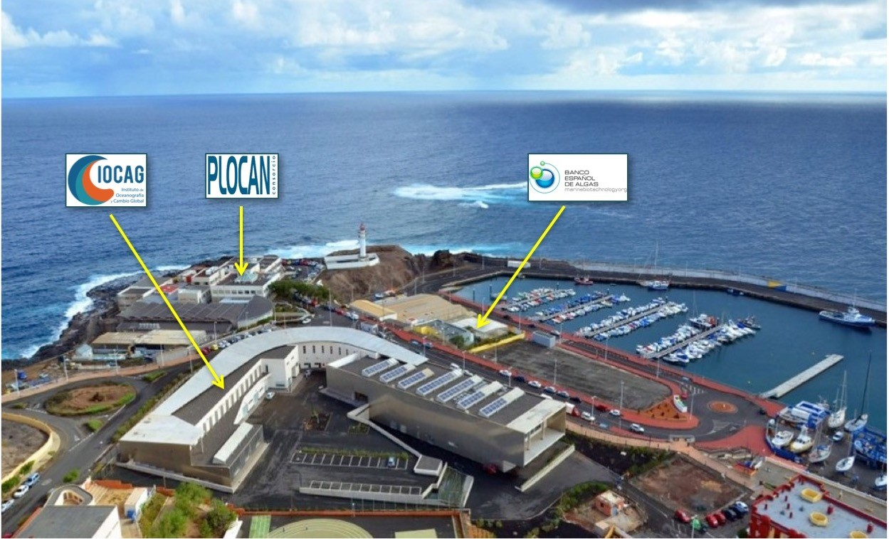
Plans for 2023 (year 3)
During 2023 we will hold a method intercomparison workshop and training course (D9) at the University of Las Palmas de Gran Canaria in order to progress the method intercomparison paper and dataset (D8), the best practice methods manual (D7) and the online training materials (D10).
We will also submit the position (D2) and model intercomparison (D3) papers, progress the global dataset (D4), draft the data paper (D5) and start a second round of mentoring projects.
Training course
Provide hands-on experience in state-of-the-art methods to determine respiration
Raise awareness of the benefits and limitations of each method
Provide insight into how laboratory and shipboard data inform model algorithms
Provide hands-on training activities in how to compare model outputs to observations of respiration

Slide 7
Thank you SCOR

