Slide 1
Developing capacity
Photo: Eduardo Klein

Slide 2
INTERNATIONAL WORKSHOP ON APPLICATION OF OCEAN SCIENCE AND TECHNOLOGY FOR THE PRACTICE OF SUSTAINABLE “BLUE ECONOMY” IN DEVELOPING COUNTRIES
8 - 9 NOVEMBER 2021
(VIRTUAL-MODE)
Jointly Organised by
Centre for Science and Technology of the Non-Aligned & Other Developing Countries (NAM S&T Centre), New Delhi
and
Committee on Capacity Development of the Scientific Committee on Oceanic Research (SCOR), Newark, Delaware (USA)
Miloslavich et al. (In press). Developing Capacity for Ocean Science and Technology. In: Ittekkot, V. and E. Urban (eds). Blue Economy: An Ocean Science Perspective. Springer Singapore.

Slide 3
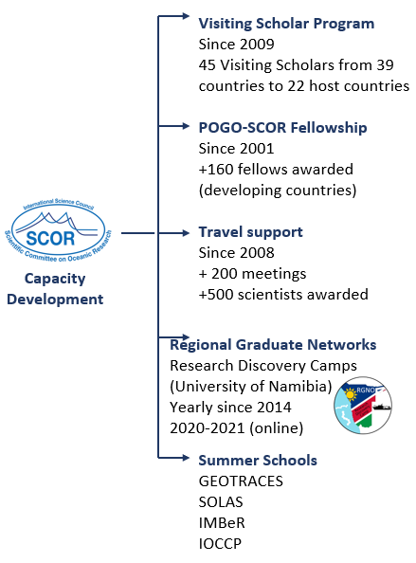
October 2021-2022: capacity development
Photo: Eduardo Klein

Slide 4
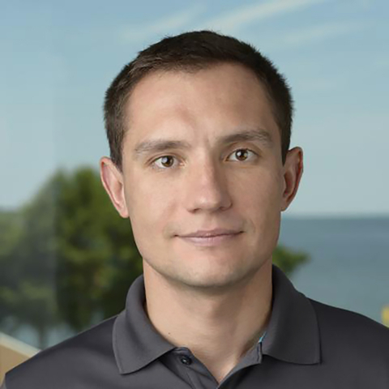
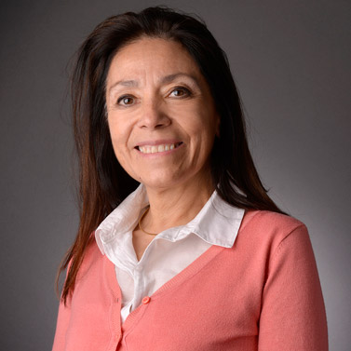
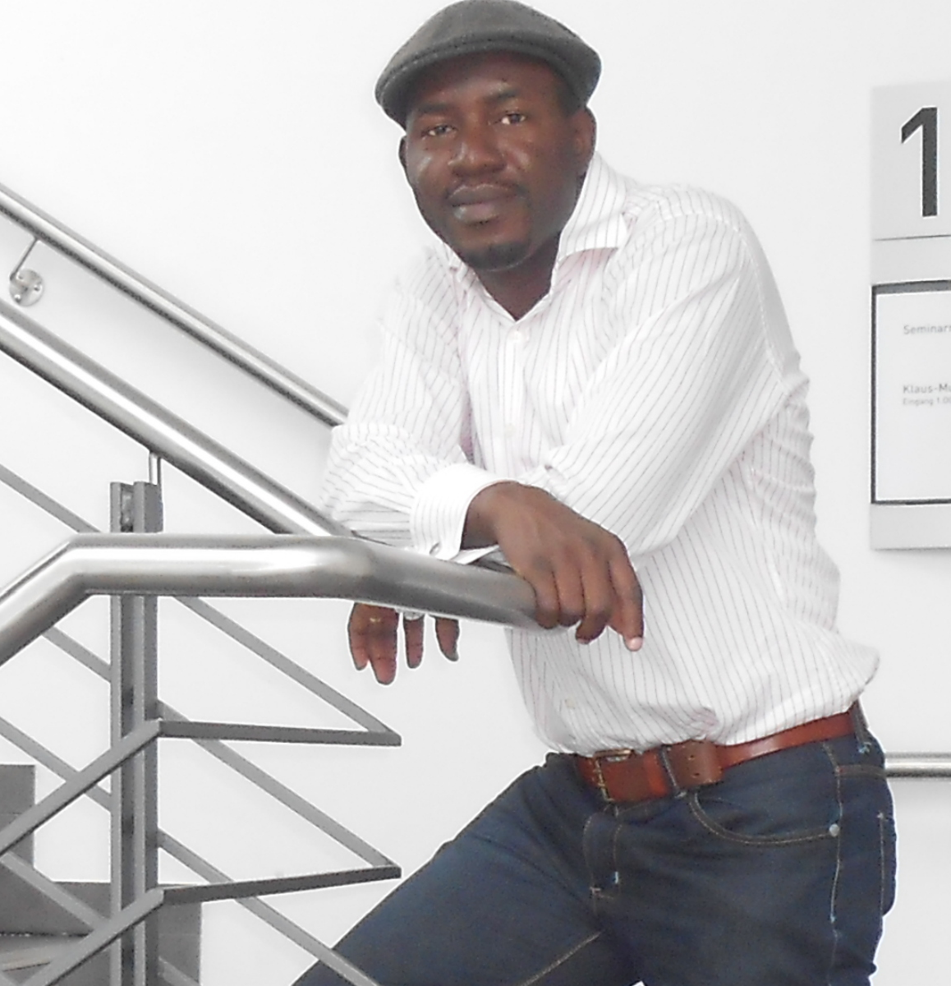
SCOR Visiting Scholars 2022 (9 applications)
Vyacheslav Lyubchich
University of Maryland, USA.
Popular methods of machine learning for ocean sciences.
Federal University of Parana, Brazil.
Elva Escobar-Briones
Universidad Nacional Autónoma de México.
Regional capacity development program on deep sea topics including deep-sea conservation.
University of Costa Rica.
Nubi Olobunmi Ayoola
Nigerian Institute for Oceanography and Marine Research.
Marine pollution and ecotoxicology.
Atlantic Technical University at Sao Vicente, Cape Verde.

Slide 5
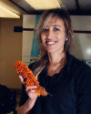
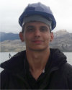
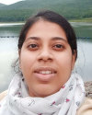
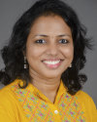
POGO-SCOR Fellowships 2022 (29 applications)
María Emilia Bravo
Argentina to USA
Taxonomy of polychaetes in methane seeps
Bredon Damini
Brazil to UK
Autonomous underwater vehicles as a tool to improve Antarctic shelf regions studies (SeaGlider data).
Maya Eria Sinurat
Indonesia to Italy
Altimetry Data Processing Training for Sea Level Trend and Variability Studies
Anwesha Ghosh
India to UK
Integrating coastal observations to explore the biological impacts of climate change
Sangeeta Naik
India to UK
Bacterial farming by mixoplankton in the global oceans; an integrated in vivo & in silico training programme
Isabelle de Oliveira
Brazil to Norway
Ocean-Atmosphere processes in response to climate change in the tropical South Atlantic.

Slide 6
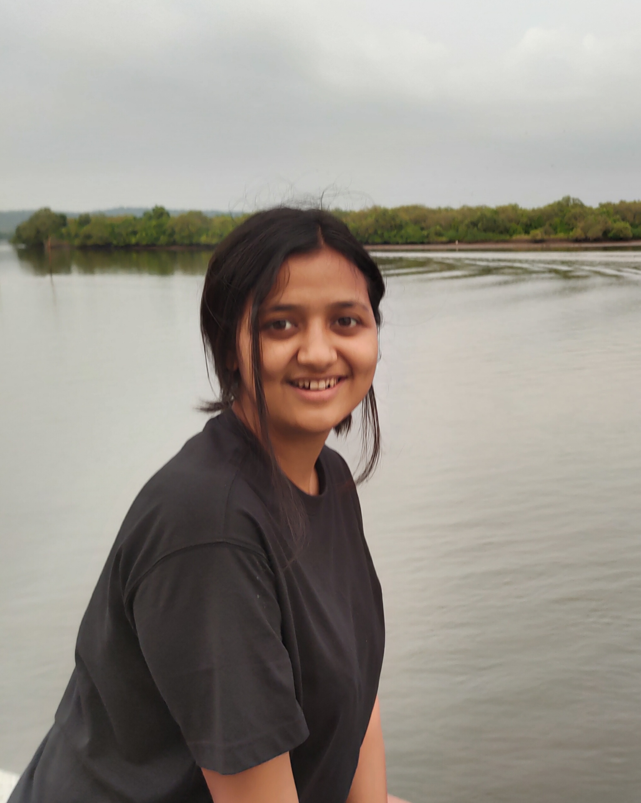
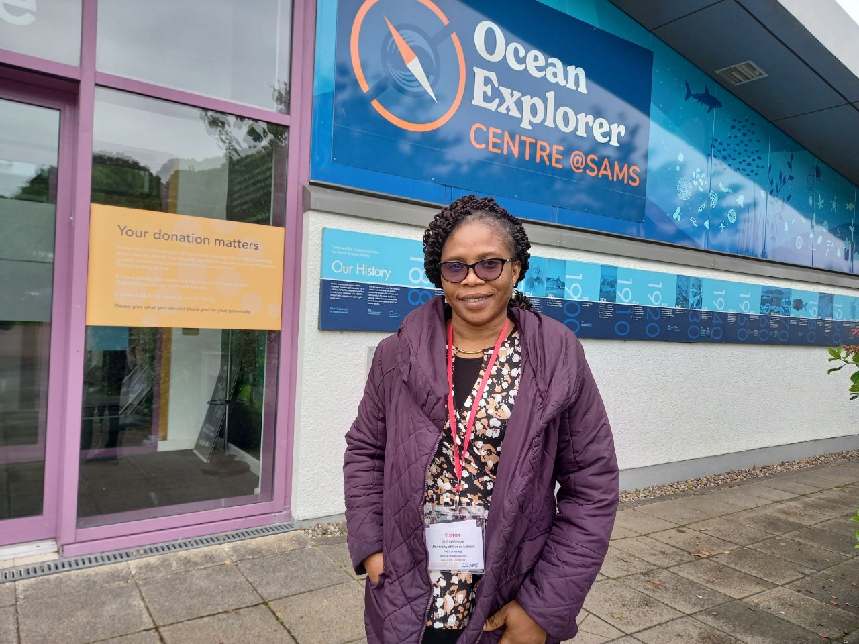
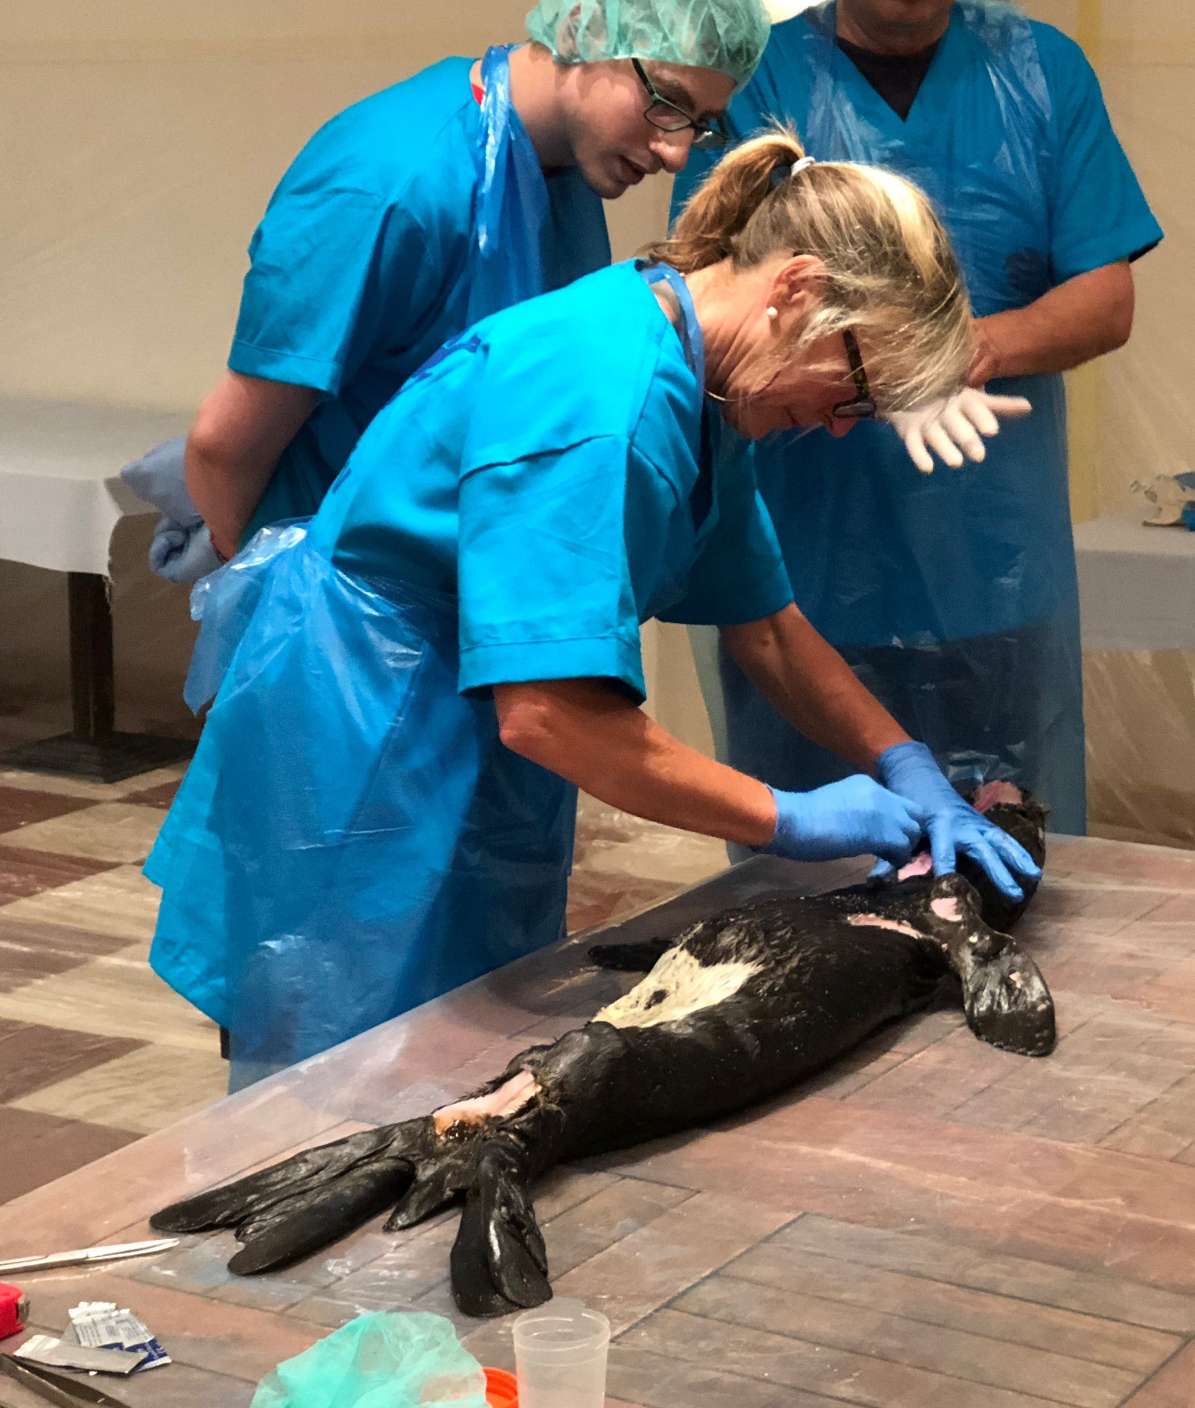
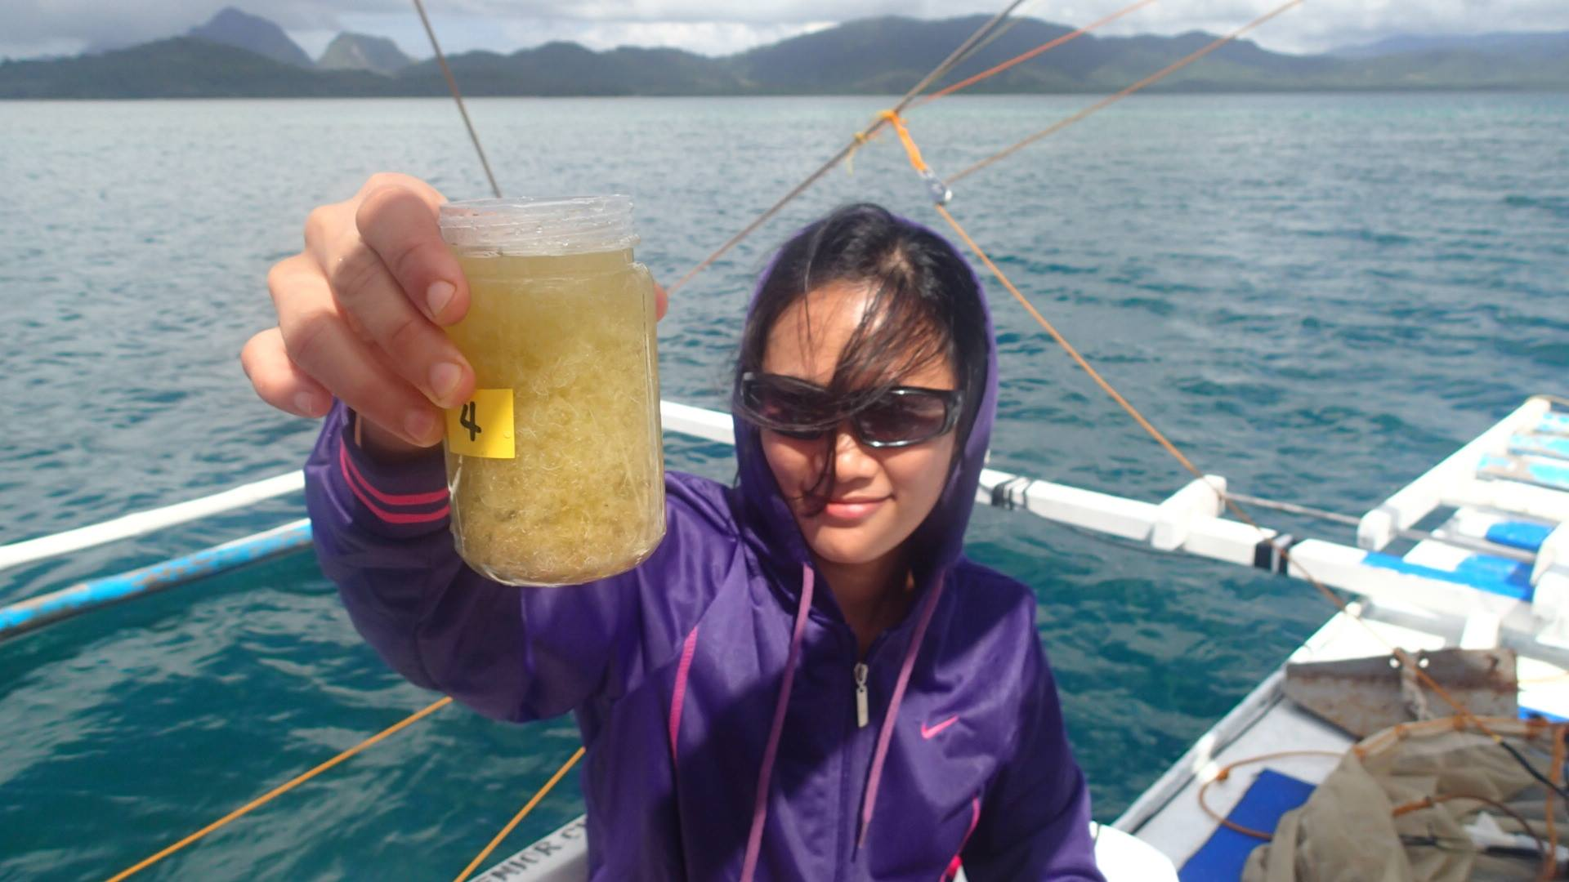
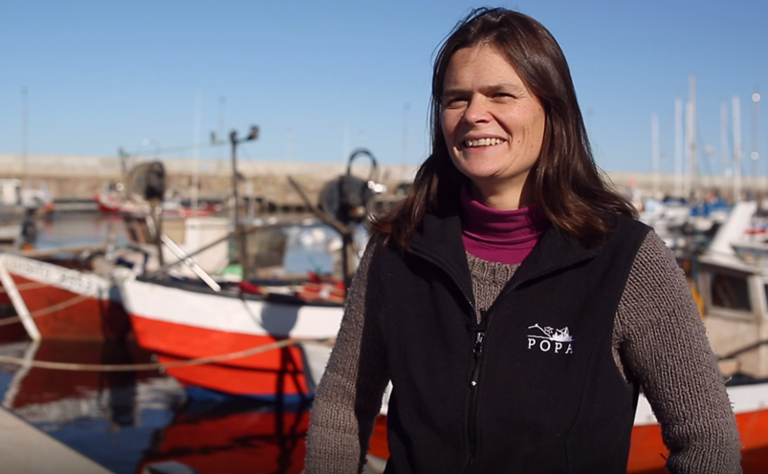
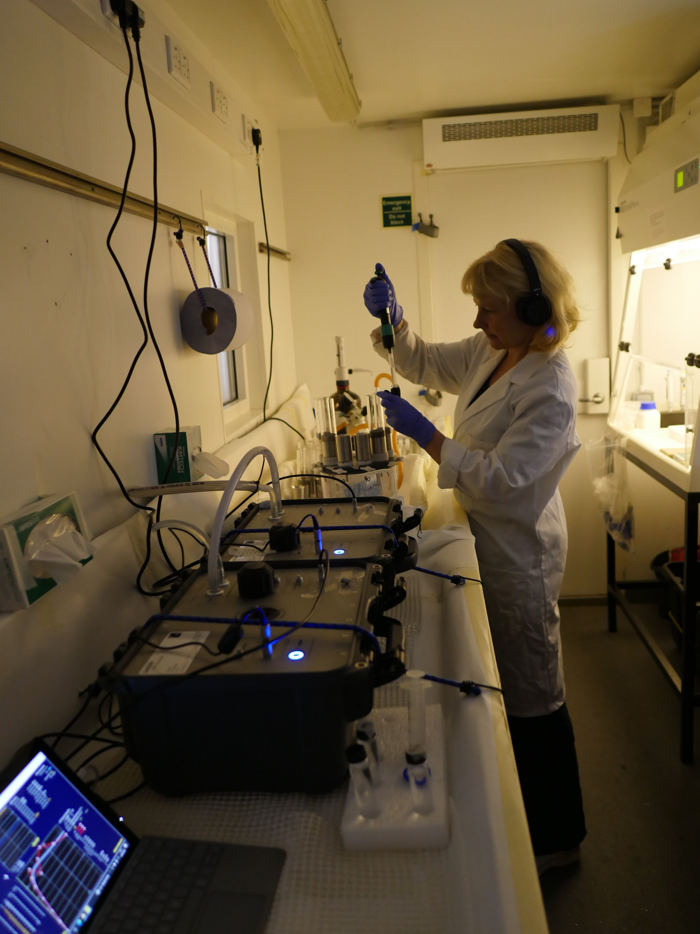
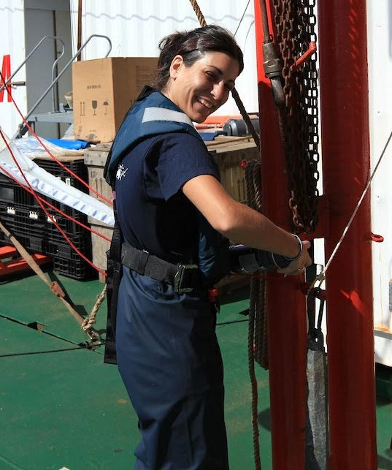
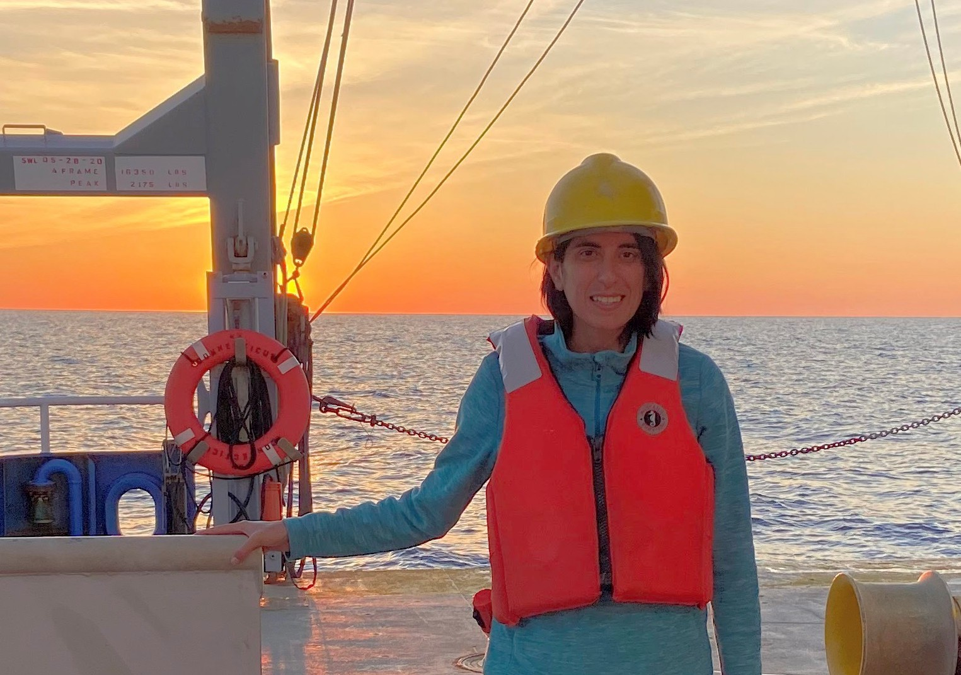
“Exceptional” SCOR Fellow/Scholar (8 applications)
Saumya Silori
India to Spain
ReMO - fellow
Amii Usese
Nigeria to UK
IMBeR - fellow
Frances Gulland
USA to South Africa
GlobalHAB - scholar
MaryMar Payne
Philippines to Japan
MetaZooGene - fellow
Micaela Trimble
Uruguay to Canada
IMBeR - fellow
Nina Schubak
Germany/UK to Brazil
WG 156 - scholar
Natalia Osma
Chile to Span
ReMO - fellow
Luciana Santoferara
USA to Argentina
WG 165 - scholar

Slide 7
Travel Support (US$ 73K)
Small Pelagic Fish: New Frontiers in Science for Sustainable Management / Joint PICES-ICES, November 2022
Gordon Research Conference and Seminar on Ocean Biogeochemistry (GRC and GRS), April-May 2022
Fourth ICES PICES Early Career Scientist Conference, May 2022 (postponed to 2023)
Low oxygen environments in marine and coastal waters: Drivers, consequences, solutions, May 2022
Ocean Mixing Gordon Research Conference and Gordon Research Seminar, June 2022
Committee on Space Research (COSPAR) 44th Scientific Assembly, July 2022
5th International Symposium on the ocean in a high CO2 world, September 2022
Ramon Margalef Summer Colloquia (RMSC): Past, present and future of a living ocean, September- October 2022
Planning Meeting for Global Library of Underwater Biological Sounds (GLUBS), July 2022
SOLAS Open Science Conference 2022, September 2022
Ocean Optics XXV Conference, October 2022
2022 Goldschmidt Conference, July 2022
Open Science Conference on Eastern Boundary Upwelling Systems (EBUS): Past, Present and Future / SCOR WG #155 (EBUS), September 2022
Best practices for the collection and processing of ship based underway flow-through optical data, August 2022
VI Latin American Symposium of Polychaeta, SILPOLY 2022, November 2022
3rd GEOTRACES Summer School: Introducing polar parameters, July 2022

Slide 8
African Regional Graduate Network in Oceanography (A-RGNO)
Discovery Research Camp in Namibia: onsite April-May 2022
Yearly since 2016 (except 2 COVID years)
Supported by Agouron and Simmons Foundations
Coordinated by Kurt Hanselmann (Switzerland) and Chibo Chikwililwa (UNAM – passed away in 2021)
Margit Wilhelm (UNAM) appointed to take the coordination of the course
New MoU signed between SCOR and UNAM establishing the scope of cooperation between both parties and the administrative terms.
The MoU was signed for one year (2022) and its renewal (and terms of renewal) conditioned to the recommendations of the SCOR Committee on Capacity Development after reviewing the program.
SCOR Committee on Capacity Development: Claudia Benitez‐Nelson, Chair (USA), Sanae Chiba (Canada/PICES), Vanessa Hatje (Brazil), Ntahondi Nyandwi (Tanzania), Rui Seabra (Portugal), Paula Sierra (Colombia), Jennifer Verduin (Australia), Sun Xiaoxia (China-Beijing), Rebecca Zitoun (Germany)

Slide 9
African Regional Graduate Network in Oceanography (A-RGNO)
Review
A-RGNO entered the last phase of funding
The SCOR Committee on Capacity Development reviewed the program to:
evaluate the A-RGNO’s major achievements since its implementation in 2014
stimulate the A-RGNO to plan for its major activities until 2025 (conditioned to the funder’s approval of a no cost extension until then)
determine whether and how we should proceed with further funding and applying for future RGNO-type programs.
The review process was intended to be useful for the parties involved, both SCOR and the University of Namibia (UNAM) along with the many partners to the program, by providing the opportunity to reflect on past achievements, on limitations, and to envision future paths.

Slide 10
African Regional Graduate Network in Oceanography (A-RGNO)
Review
Overarching goals of the Namibian Discovery Camp are to:
Support local scientific capacity to acquire practical skills – some achieved
Inspire students to envision becoming oceanic researchers or finding positions in related fields – could not assess
Provide opportunities to engage and network with international early-, mid, and senior-scientists – some achieved
Promote training and confidence to collaborate in international research projects and actively contribute to SCOR working groups – could not assess
Identify needs and propose research projects that are of local or global importance – some achieved
Engage interested researchers to contribute to executing research, always linked to teach and train students – some achieved

Slide 11
African Regional Graduate Network in Oceanography (A-RGNO)
Review
Reccommendations:
1) Increase the number of students from Namibia and other African countries.
-Course content: update to reflect current needs (e.g. Blue Economy)
-Academic credit: within a formal postgraduate peogram (e.g. UNAM in development)
-Student support: provide stipend to students for participating
2) Institutionalization and engagement of local and regional faculty in A-RGNO.
-Administrative and Technological Support: providing salaries for local organizers
-Expansion of Support: e.g. UN Ocean Decade, POGO, West African Science Service Centre on Climate Change and Adapted Land Use (WASCAL)

Slide 12
African Regional Graduate Network in Oceanography (A-RGNO)
Review
In summary:
The A-RGNO Research Camps have provided numerous opportunities to bring together faculty and students from across the world to study the Benguela Current in partnership with SANUMARC, UNAM, NatMIRC and MFMR of Namibia.
The CD Committee report provides constructive comments that should be used over the next year to develop a strategy for increasing collaborations and developing institutional buy in.
The CD Committee recommends that Camp organizers develop metrics and indicators for assessing Camp goals that evaluate the long-term capacity development success across all groups: International and local students, visiting scholars and local faculty, and Namibia institutional partners. A timeline of how and when recommendations are to be implemented should be established as well as how and why future funds will be allocated.

