Slide 1
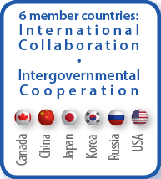
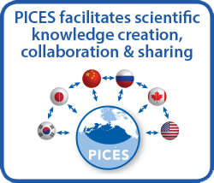
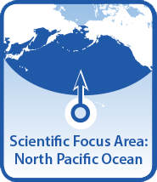
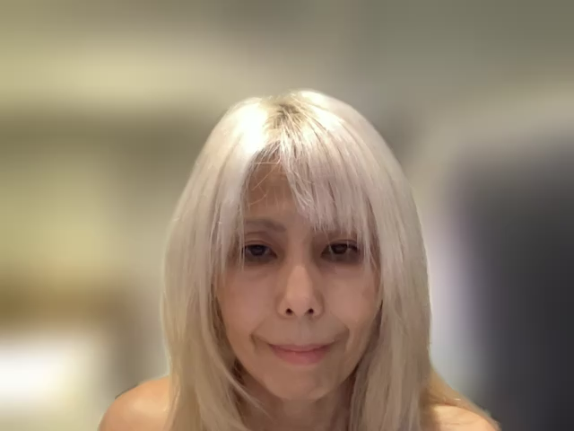
PICES is an intergovernmental science organization, established in 1992,
to promote and coordinate marine scientific research in the North Pacific Ocean
and its adjacent seas in order to advance scientific knowledge of the area.
Notes:
Hello. I am Sanae Chiba, Deputy Ex Secretary of the North Pacific Marine Science Organization aka PICES
Thank you for inviting PICES to SCOR annual meeting
PICES is an Intergovernmental organization, comprising 6 member countries around the NP Ocean.
PICES functions as the forum, which provides our communities with
opportunities and frameworks for collaboratively creating and sharing scientific knowledges
PICES can play an important role in bringing a North Pacific perspectives to the global activities of SCOR,
1

Slide 2
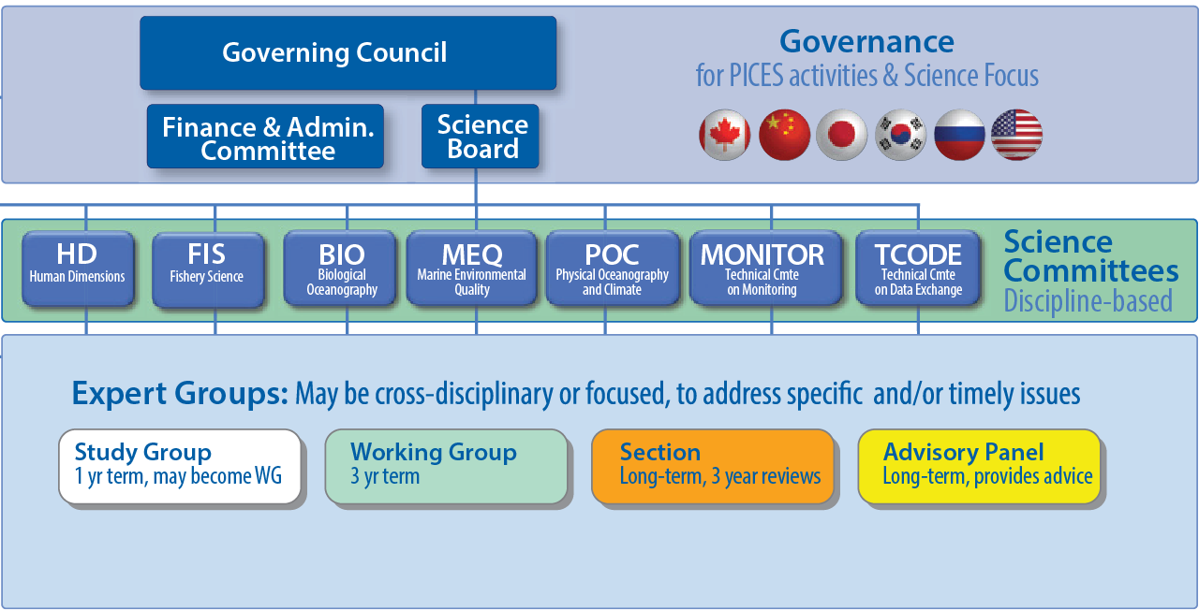


Special Projects
Notes:
This is the structure of PICES
Governing Council (GC) is the decision-making body consisting of government representatives of the member countries.
Science Board is in charge of setting the direction of PICES science.
SB has 7 standing committees, and under the committees,
there are many Expert Groups which implement scientific projects in multidisciplinary areas.
The role and function of these EGs are somehow similar to that of SCOR WG
2

Slide 3
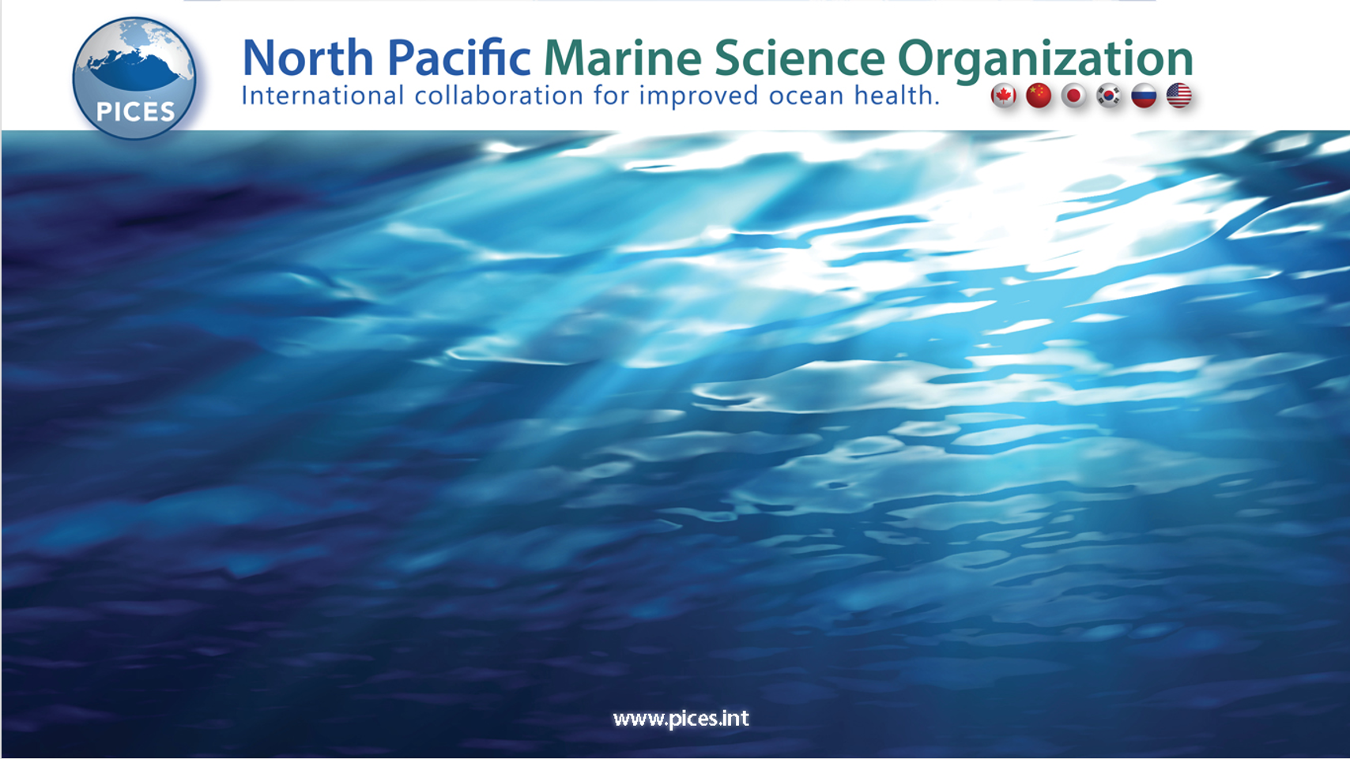
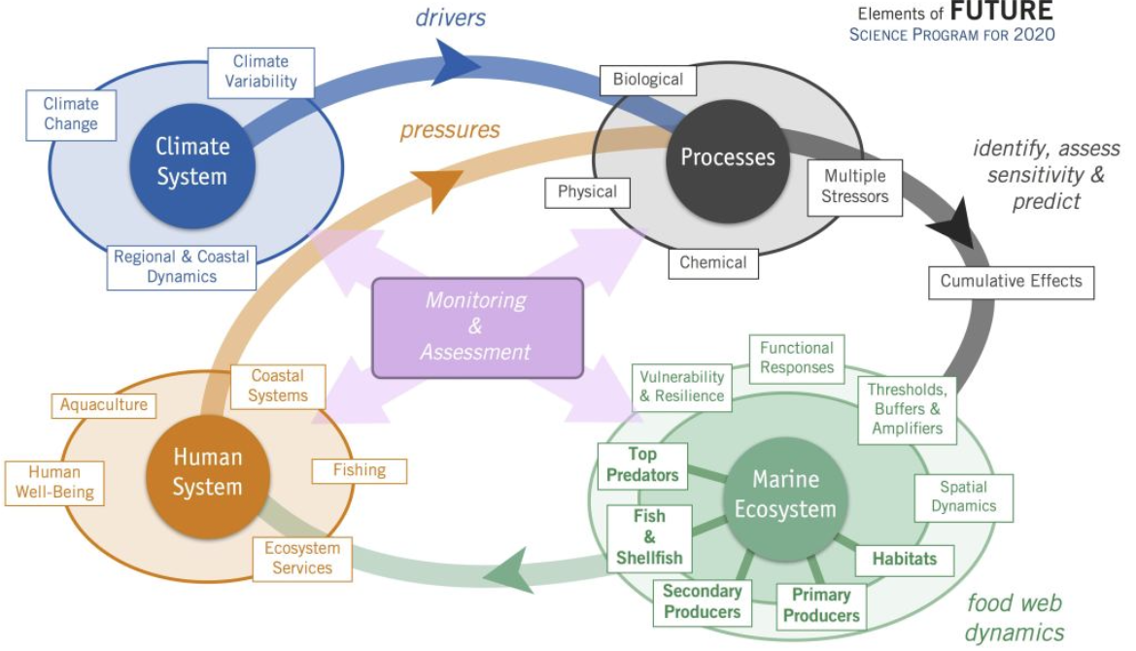
FUTURE Schematics of Social-Ecological-Environmental System Framework
To understand the Climate System, Processes, Marine Ecosystem, and Human System in an integrated way. Central to this system is the long-term and sustained monitoring and assessment.
Notes:
The activities of these EGs are integrated and mapped on the Social-Ecological-Environmental System Framework,
Which is set by the PICES flagship programme FUTURE
This framework describes the links between the foci of PICES EGs
over the components of Climate System, Processes, Marine Ecosystem and Human System

Slide 4

Notes:
Last year,
PICES and ICES jointly launched the UNDOS-endorsed program: SmartNet,
SmartNet is a Networking Programme.
Its goal is to establish a global knowledge network for ocean science
It will support and leverage ICES/PICES member countries' activities
for generation and transfer of scientific knowledge.
ICES and PICES together, the geographical coverage reaches the entire Northern Hemisphere

Slide 5



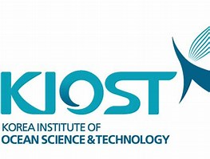











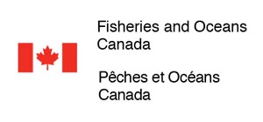



















Intergovernmental organizations
National marine science agencies
Academic organizations and Foundations
International programs
Notes:
But our ambition is to reach out to communities beyond the Northern Hemisphere.
SmartNet aims to facilitate partnerships and joint activities with global communities
to bring solutions to global issues
We have already developed good communication with
programmes and organizations in the Asian countries and Southern Hemisphere.

Slide 6

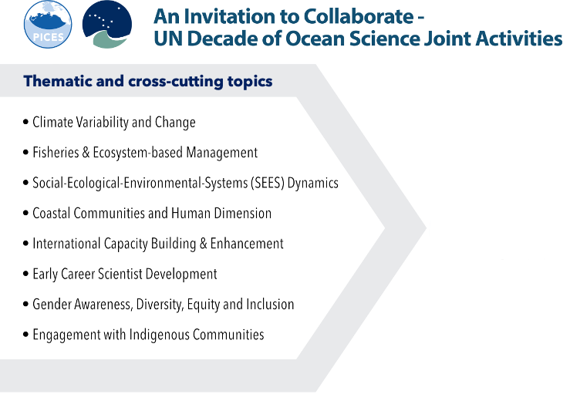
SmartNet Program Scientific Themes and Activities
ICES/PICES Joint Expert Groups
Small pelagic fish ecology and sustainable management
Ocean negative carbon emission
Integrated Ecosystem Assessment for the Arctic Ocean
Impacts of warming on growth rates and fisheries yield
Climate change effects on marine ecosystems
Thematic Topics
See the details on our Websites!
https://www.ices.dk/community/groups/Pages/default.aspx#k=PICES
https://meetings.pices.int/members/working-groups
Notes:
Smartnet has key thematic topics in which ICES and PICES have expertise and mutual interests:
For example, in the areas of climate – ecosystem nexus.
These topics are addressed by activities of the existing ICES/PICES joint working groups
Also, through the collaboration with new partners.

Slide 7

Frameworks
Early Career Professionals support
Science Communications Strategy
Capacity development scheme
Partners for wider community engagements
Asia-Pacific Network for Global Change Research (APN)
Ocean Network Canada
Ocean Knowledge-Action-Network
and many more…
Cross-cutting Topics
Notes:
But what I want to stress today is the cross-cutting themes of SmartNet.
Click
These topics are addressed through the ICES/PICES frameworks for
- Promotion of Early Career Ocean Professionals
- Science Communication strategy
- Capacity development schemes
Click
This is the area PICES would like to explore opportunities with SCOR

Slide 8
SCOR – PICES Collaboration
in Capacity Development
Membership in the SCOR Capacity Development Committee
Mutual supports for ECS and scientists from developing countries to participate in SCOR and/or PICES sponsoring International Symposia/Conferences
Notes:
SCOR and PICES have a long history of collaboration in capacity development.
Myself is currently a member of SCOR Capacity Development Committee
We have supported each other’s programmes and events

Slide 9





SCOR Support for PICE Sponsored International Conference
PICES Support SCOR Partners Capacity Development Event
SOLAS Open Science Conference 2022
September 25th - 29th, 2022, Cape Town,
South Africa
PICES funds US$4500 for ECOPs travel support
and ECOP event
SOLAS Summer School 2023
Cape Verde, Senegal
PICES funds CA$ 10K for travel support of
ECOPs.
IMBeR ClimEco8 Summer School 2023
July 24-28, 2023 ** PICES’s support: TBD
ICES/PICES/FAO
SPF-2022
Small Pelagic Fish: New Frontiers in Science for Sustainable Management
Lisbon, Nov. 2022
ICES/PICES ECCOW
Small Pelagic Fish: New Frontiers in Science for Sustainable
Bergen, April 2023
Notes:
For example, This year,
SCOR supports the participation of scientists from developing countries to the conference “Small Pelagic Fish: New Frontiers in Science for Sustainable Management” which will be held in next month in Lisbon.
ECCOW
PICES is applying for SCOR travel support fund to help participants of the Effect of Climate Change on the World’s Ocean which will be held in the next April in Bergen
Click
Other way round,
PICES supports capacity development events, such a summer school, organized by SCOR partner projects.

Slide 10
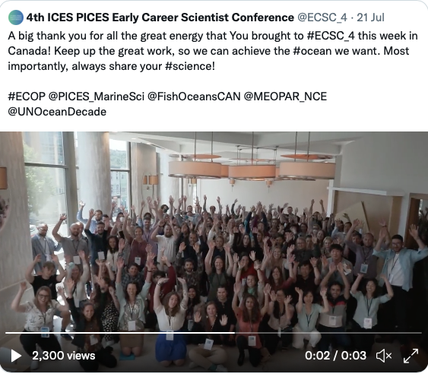

SCOR Support for PICE Sponsored International Conference
4th ICES PICES Early Career Scientist Conference
St John’s, Newfoundland, Canada, July 17-22, 2022
Notes:
This photo is from ICES/PICES Early Career Scientist Conference held in last July in Newfoundland, Canada
This is 4th round of the same conference series, which is held every 5 years.
We much appreciate SCOR’s continuous support for the past and future conferences.

Slide 11
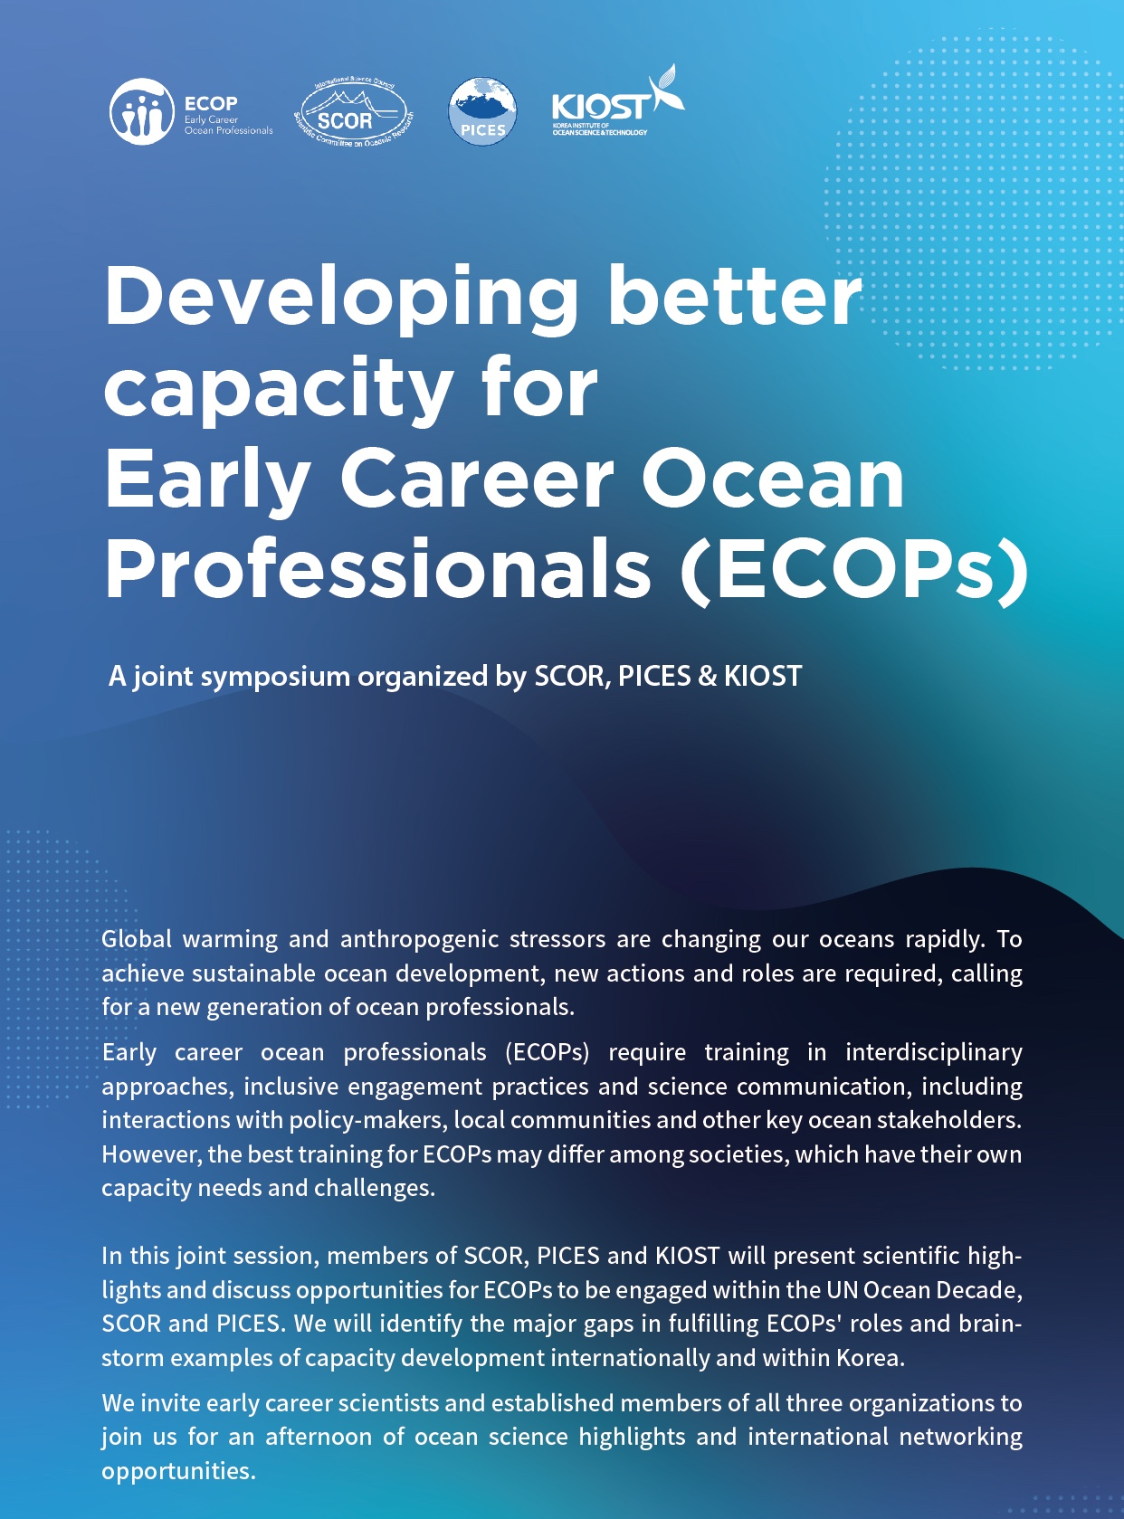
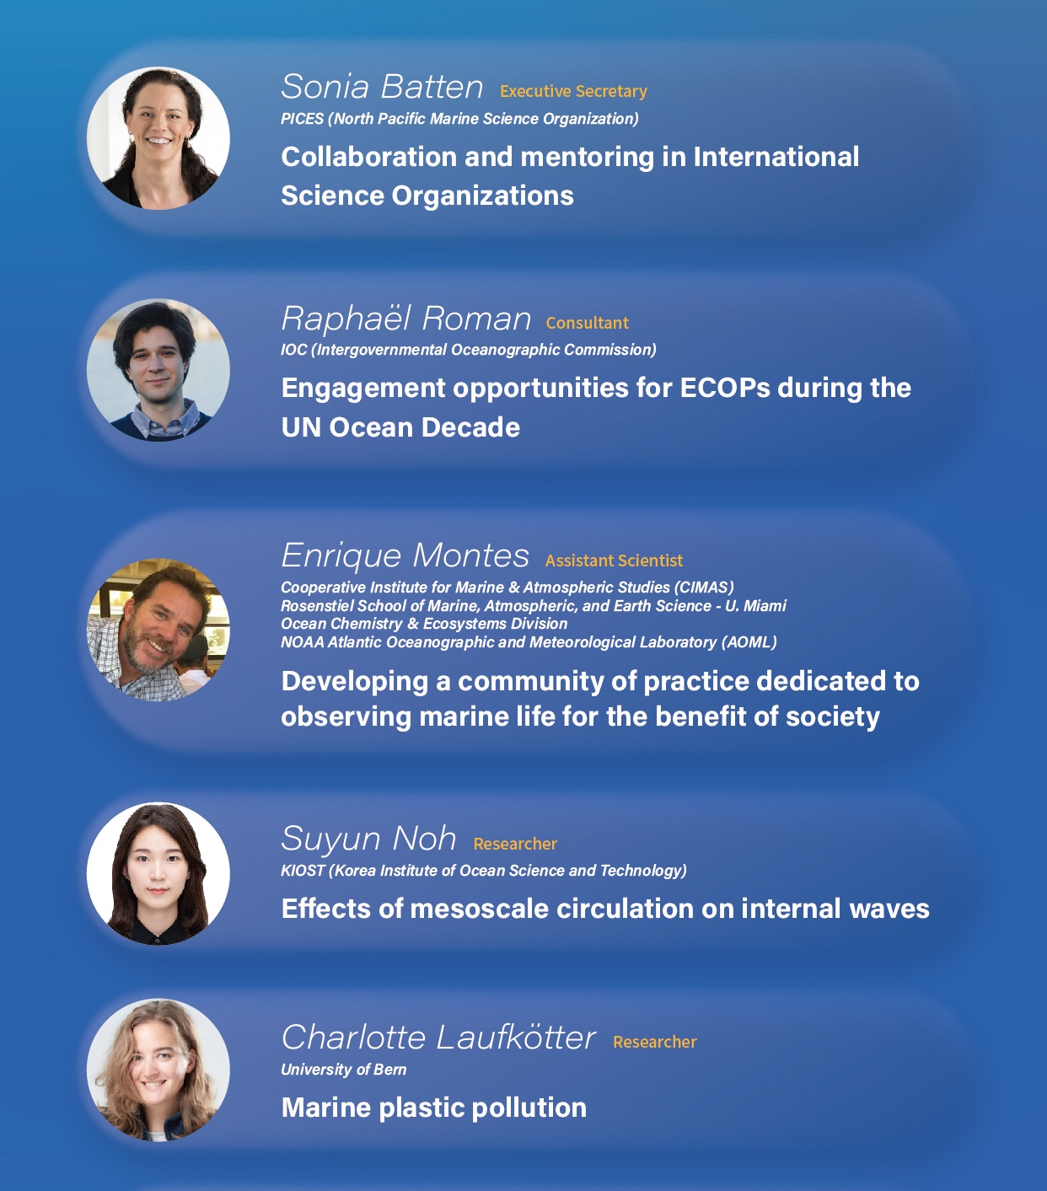
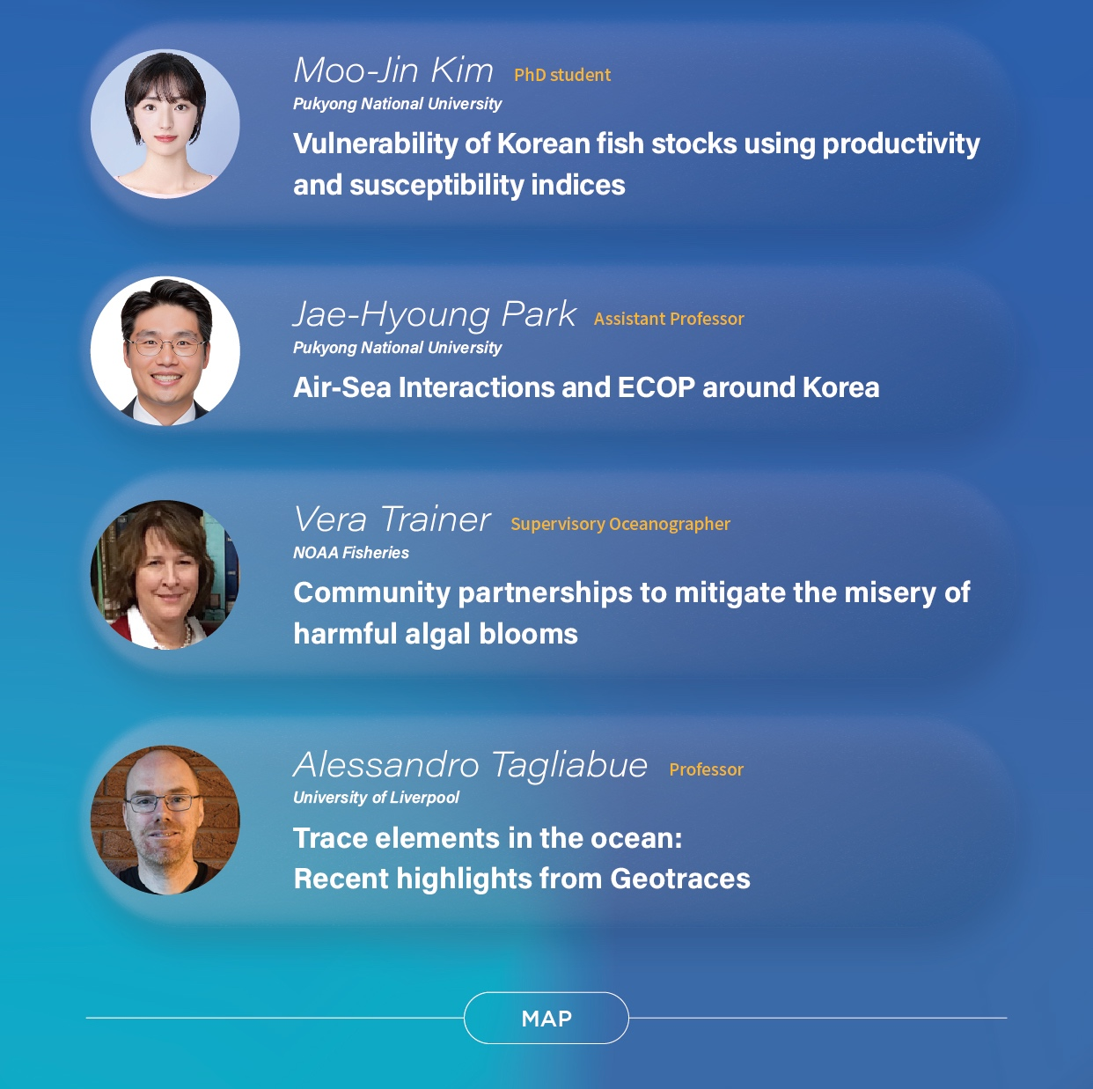
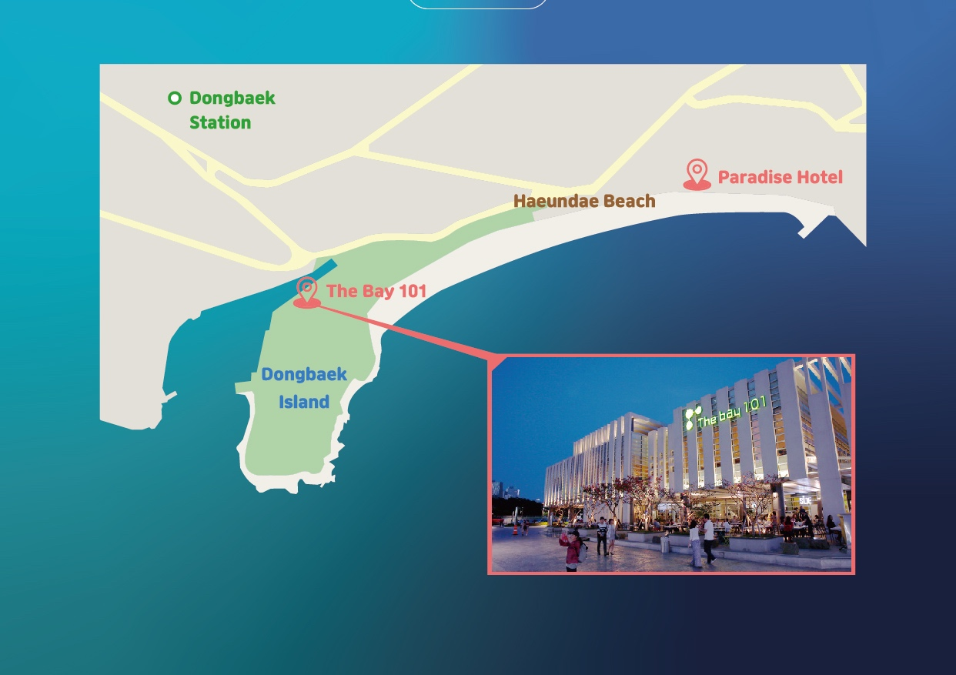
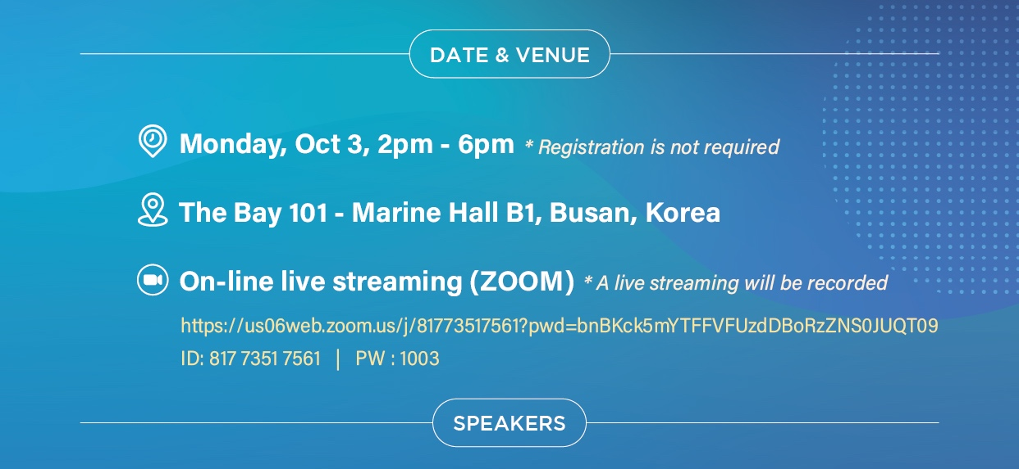
Notes:
Most recently,
On Monday this week, here in Busan,
SCOR, PICES and KIOST jointly organized the ECOP event.
Developing better capacity for Early Career Ocean Professionals.
It particulaly aims to encourage ECOPs in KOREA to engage in UNDOS activities and leadership in ocean science.
We hope to explore more and more opportunities for SCOR/PICES collaboration on similar events.

Slide 12

Thank you!
Notes:
That

