Slide 1
International Project
Office
Consortium Update
September 2022

Slide 2
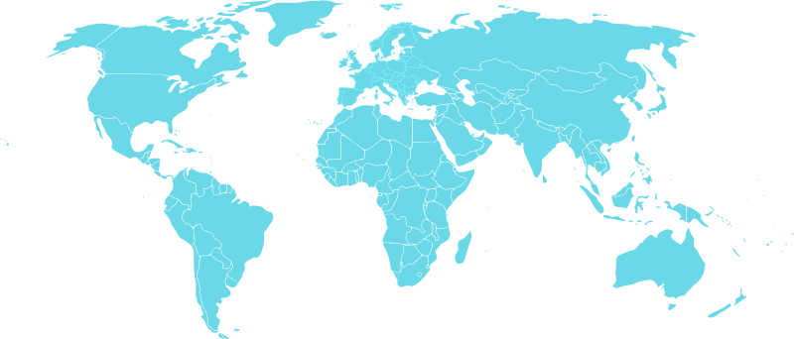
Building the Network from the Bottom Up
Network
Tula Foundation (Canada)
California
(multiple institutions)
Academia Sinica
(Taipei)
University of Ghana
University of Seychelles
UNIFESP (Brazil)
Brazilian Future Ocean Panel/Network (Brazil)
South Africa
(multiple institutions)
Notes:
Approche ascendante (bottom up) avec les partenaires sur le terrain

Slide 3
Connecting Partners to Global Science, Private Sector Partners, and UN Decade of Ocean Science
Network
International Science Networks Future Earth (IMBeR, SOLAS, Future Earth Coasts, PAGES) World Climate Research Program Scientific Committee on Oceanic Research Ocean & Climate Platform Consortium for Ocean Leadership
UN Ocean Decade Networking Programmes SmartNet (ICES-PICES and NOAA) Early Career Ocean Professionals Network (IOC) Empowering Women in the Decade (World Maritime University)
UN Ocean Decade Science and Action Programmes Marine Life 2030 Global Ecosystem of Ocean Solutions
Social and Transdisciplinary Science Earth Systems Governance - Ocean Task Force Dartmouth College Marine Social Sciences Network APOLIMER (CNRS) Campus Mondial de la Mer Middlebury Institute for Intl Studies
Private Sector Collaborations Acter.global Moonjelly.io/Moonjelly Academy Network Weaving Institute
Notes:
Connecter les partenaires à la science mondiale, aux partenaires du secteur privé et à la Décennie des Nations Unies pour les sciences océaniques

Slide 4
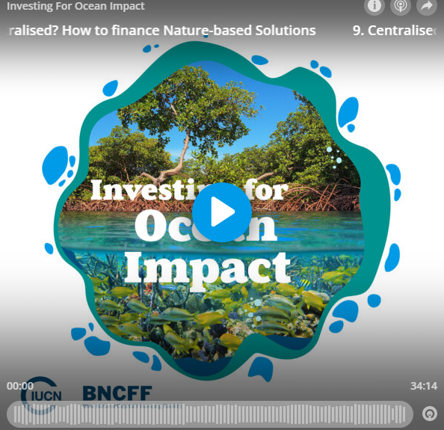
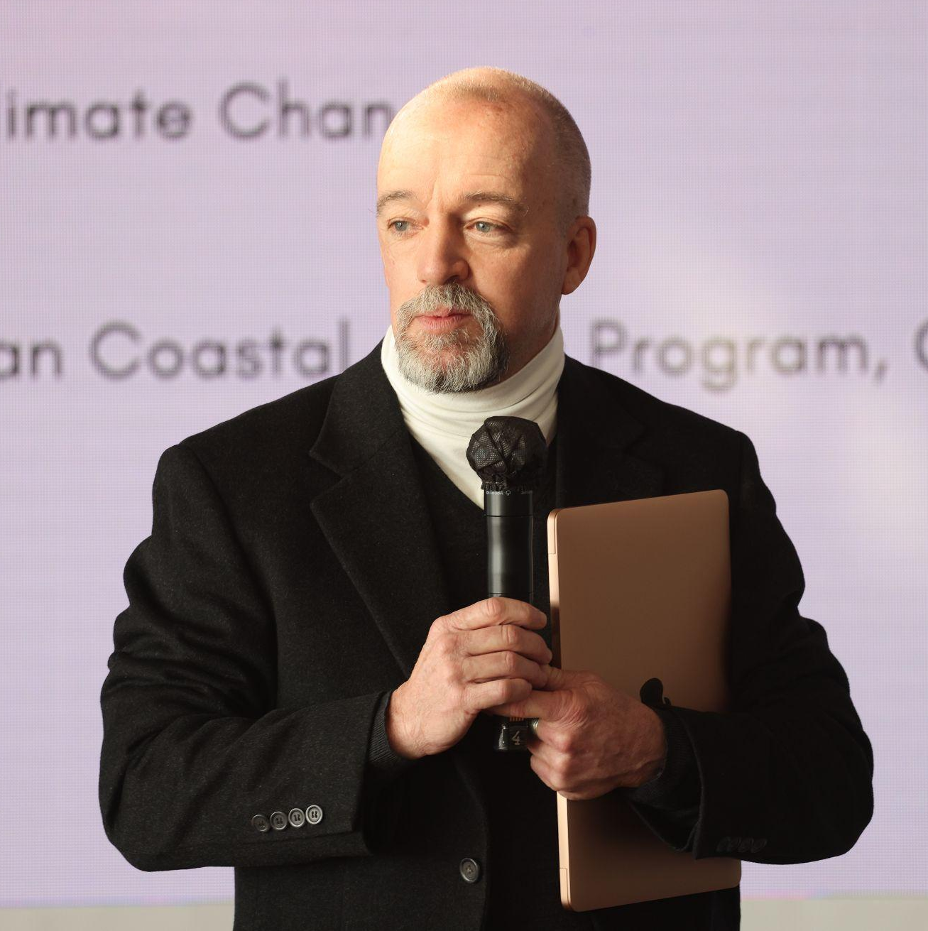
Knowledge sharing and creating
Knowledge
Ocean KANopy
Dissemination and outreach
Co-designed workspace
43 users
6 communities
e.g. Ocean KAN Seychelles, SOLAS, Moonjelly Academy
18 groups and learning circles
e.g. Rethinking remote conferences
Financial contribution by SCOR, SOLAS (€ 2000)
3 journal articles by Ocean KAN
2 special series in ICES JMS
4 published articles
10 submissions to date
2 podcasts
4 sessions and side events at international conferences
>8 presentations and webinars
Blogs (WEF, Medium, LinkedIn)

Slide 5
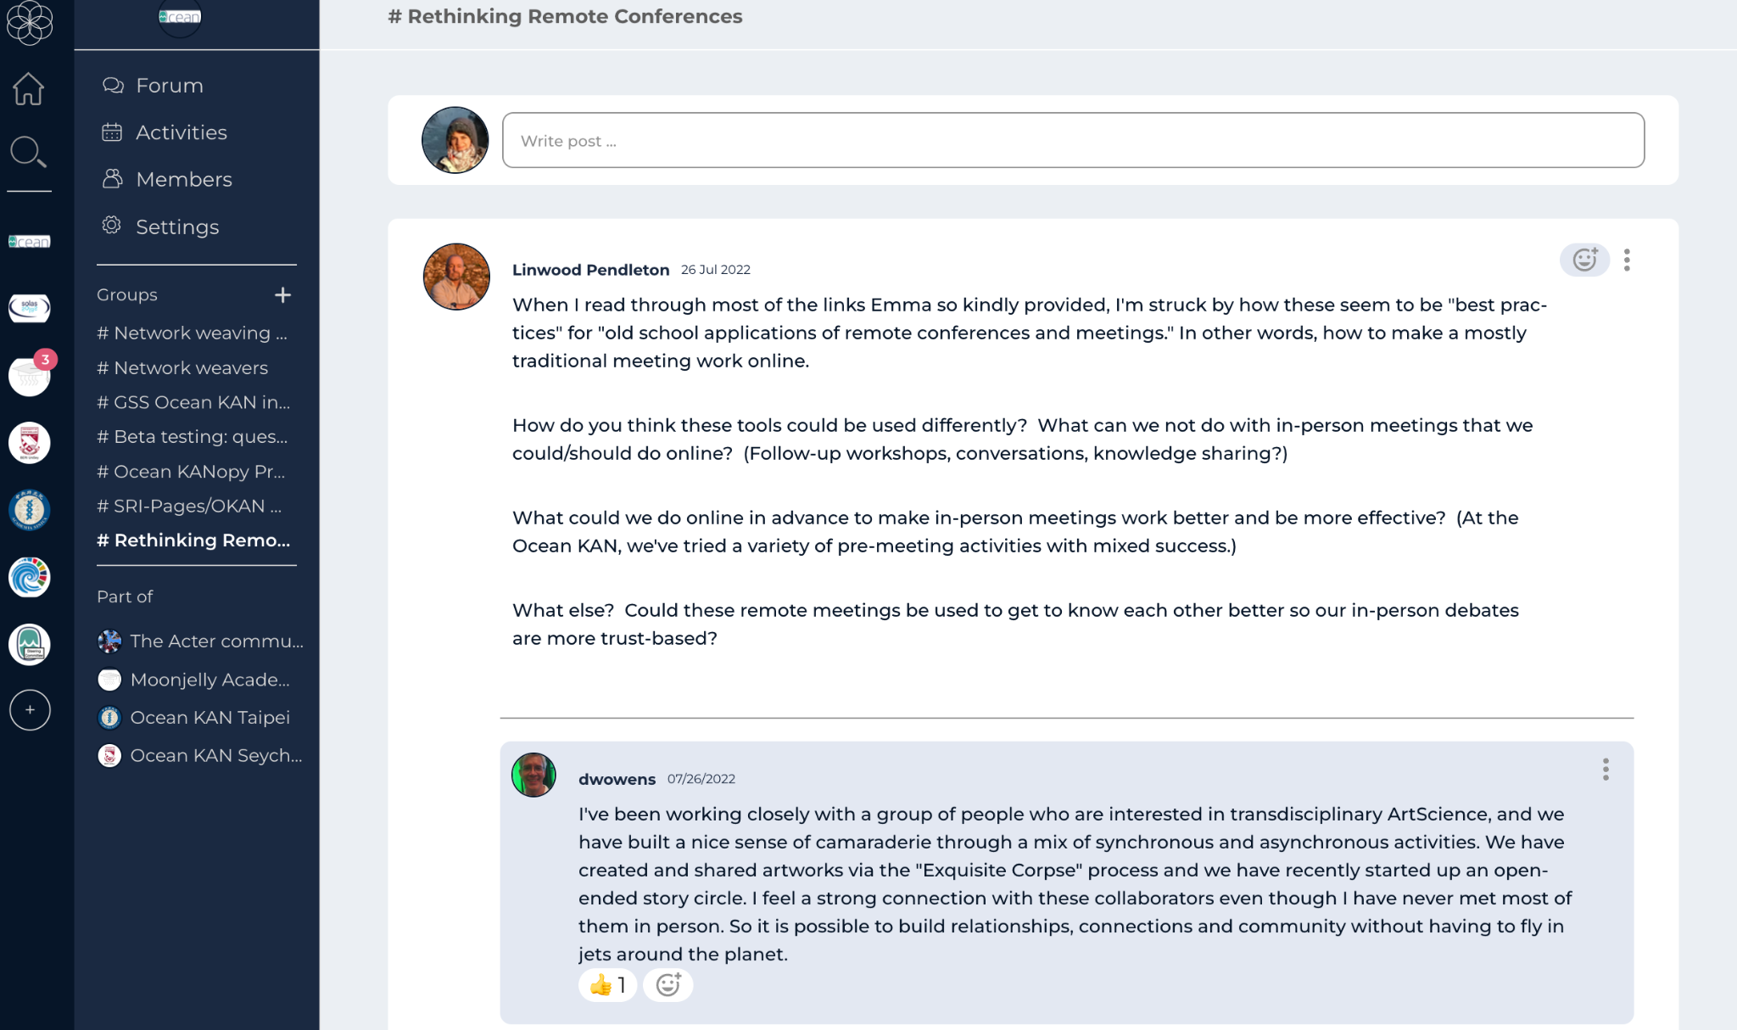
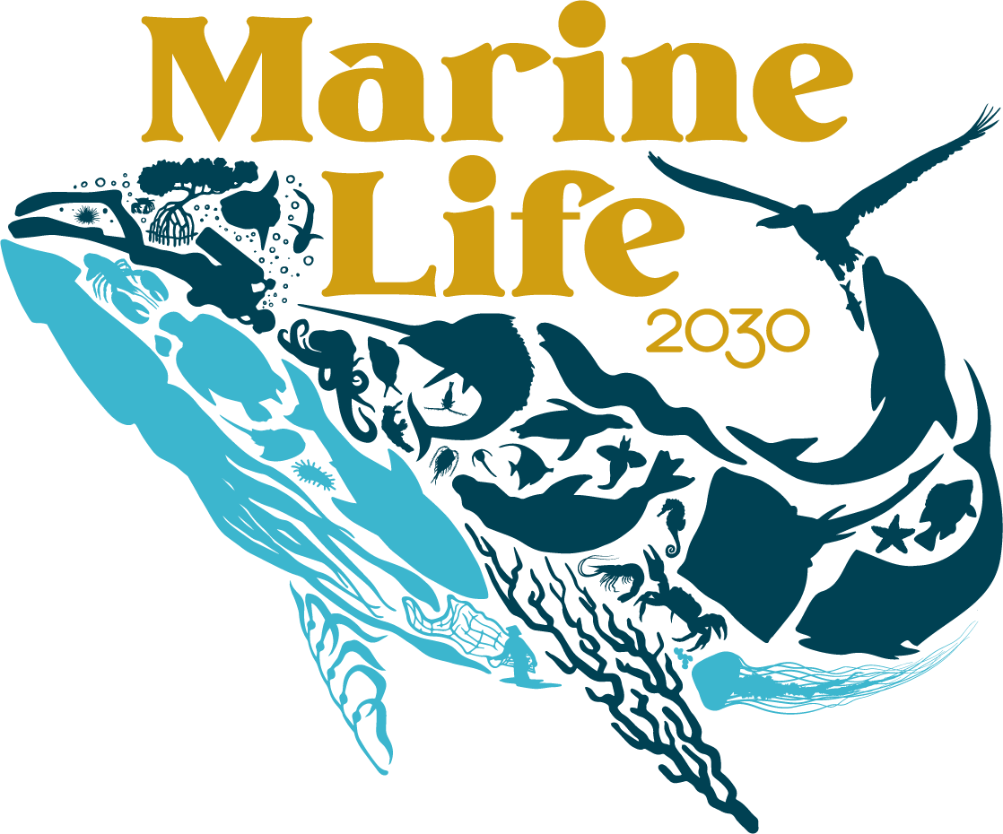
Funding, co-designing science, learning circles, mentoring
Action
SCIENCE FUNDING
CO-DESIGNING SCIENCE
LEARNING CIRCLES
Research proposals
Marine Life 2030
– Communities of Practice
Rethinking remote conferences
Henry Arnold Fellowship
Future Earth GSS (with Future Earth Coasts)
PPR and Biodiversa+ proposals (next slide)
Moonjelly Academy
– Digital frontier and ocean conservation and science
Onboarding meetings
French researchers (later slide)
Regular leadership meetings
Co-designing marine life science
ML2030 Community of Practice
Anti-colonial practices for Ocean Science, Conservation, and Finance
$392 800 to support partners in Colombia, South Africa, and Cook Islands
MENTORING
Support
Global Sustainability Scholars
Keynote at 1st Future Earth Taipei Symposium
Session for PAGES OSM
Sea and the City – Monaco 2022
4 scholars
June-July (2 months) x 2 years
2022 and 2023

Slide 6
Future Earth: Last year’s activities
Future Earth Structure: new Hubs of the Secretariat in China, India, Taipei, and South Africa
Future Earth Assembly meeting in September 2022 in Paris: reflect and design new cross cutting activities & make recommendations to the Governing Council
Science-Policy Interface:
Nomination of experts or the nexus and transformative change assessments of the IPBES
Side events at UNFCCC COP26, UNFCCC COP27, and the UN Ocean Conference
Stockholm+50: letter to the citizens of Earth together with ISC and SEI
What we can do together
Active News section (Twitter, LinkedIn, newsletter)
UN events and more

