Slide 1
SCOR Virtual Annual Meeting 2022
4-6 October 2022
In Memoriam

Slide 2
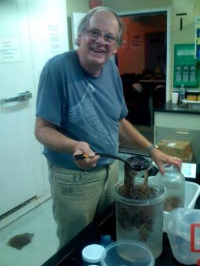
In Memoriam
Philip Roy Pugh, UK
(† 24 November 2021)
Emeritus Professor at the National Oceanography Center (NOC), UK.
Full member of SCOR Working Group #87 on Fine-Scale Distribution of Gelatinous Planktonic Animals established in 1986.

Slide 3
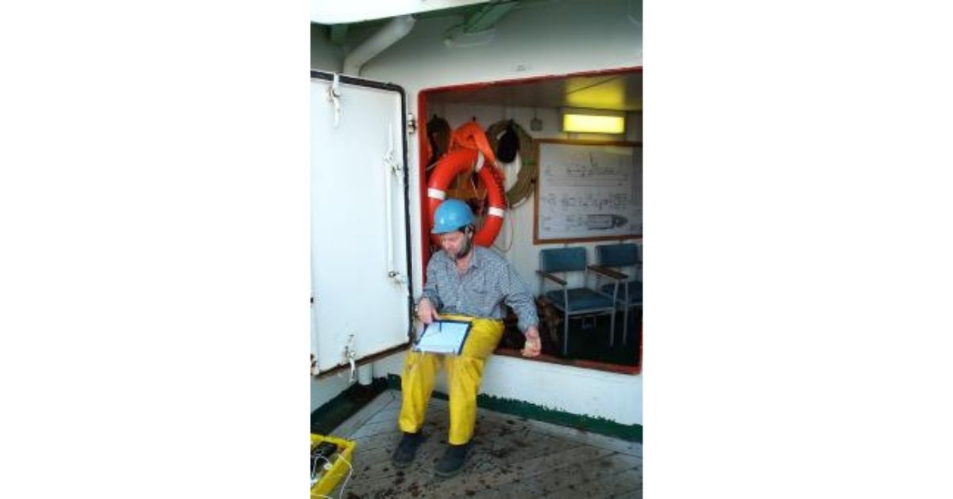
In Memoriam
Raymond Pollard, UK
(† 14 December 2021)
Physical oceanographer affiliated to the National Oceanography Center (NOC), UK.
Member of the Scientific Steering Committee of the Integrated Marine Biosphere Research (IMBeR) program from 2004-2006

Slide 4
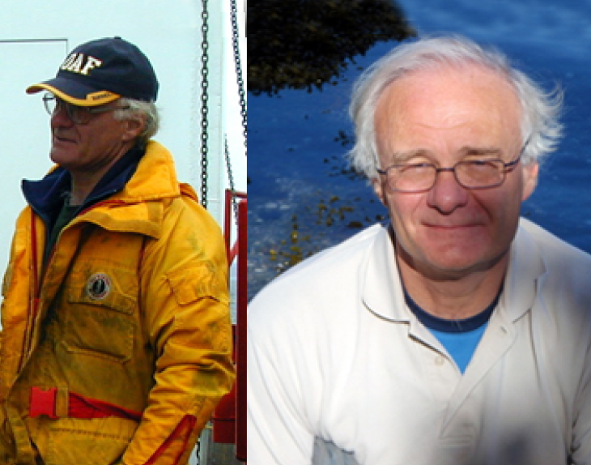
In Memoriam
Robie Macdonald, Canada
(† 13 February 2022)
Senior Research Scientist with Fisheries and Oceans Canada, Institute of Ocean Science and adjunct professor at the University of Manitoba’s Centre for Earth Observation Science.
Nominated Member of the Canadian SCOR National Committee (CNC-SCOR) and
Canadian Chair from 2009-2012.

Slide 5
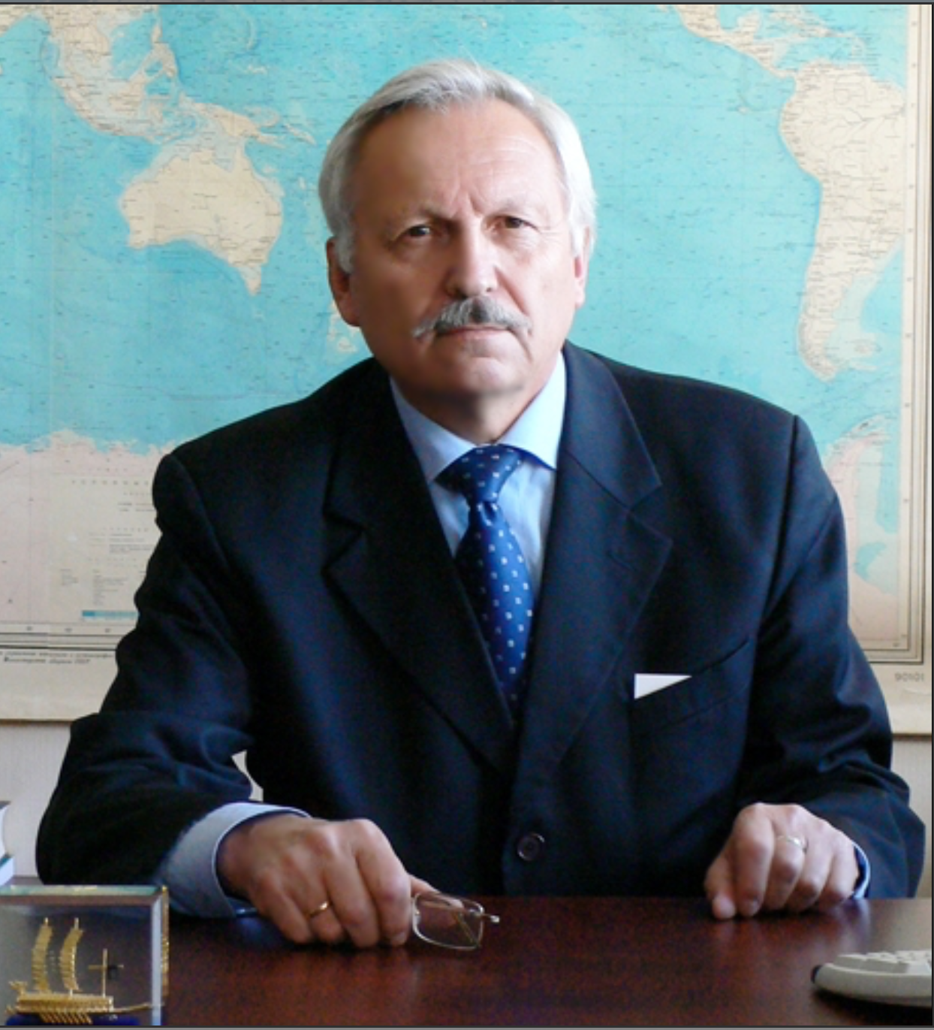
In Memoriam
Viktor Akulichev, Russia († 27 February 2022)
Academician of the Russian Academy of Sciences, Professor, and Doctor of Physical and Mathematical Sciences.
Russian Nominated Member for SCOR and Vice President of the Executive Committee of SCOR from 2004-2008.
Associated member of Working Group #96 on Acoustic Monitoring of the World Ocean established in 1991.

Slide 6
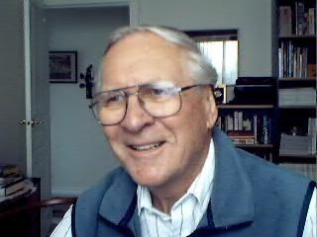
In Memoriam
Timothy (Tim) Parsons, Canada († 11 April 2022)
Retired professor from the University of British Columbia, Canada.
Chair of Working Group #24 on Estimation of Primary Production under Special Conditions established in 1964.
Vice-chair of Working Group #85 on Experimental Ecosystems established in 1986.
Ex-officio member of the SCOR Executive Committee (1976-1982) as President of the International Association for Biological Oceanography (IABO).

Slide 7
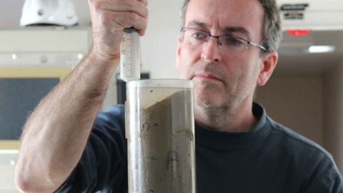
In Memoriam
Jordi Garcia-Orellana, Spain
(† 5 July 2022)
Professor at the Department of Physics of the Autonomous University of Barcelona, Spain.
Member of the GEOTRACES Scientific Steering Committee from 2011 to 2016.

Slide 8
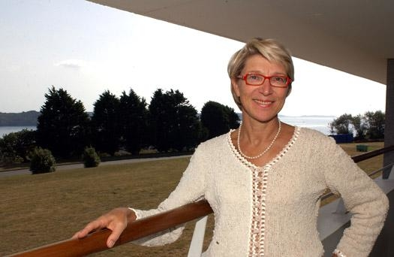
In Memoriam
Myriam Sibuet, France
(† 26 July 2022)
Retired deep-sea researcher from IFREMER, France.
Member of the Scientific Steering Committee of the Census of Marine Life, a decadal program affiliated to SCOR between 2000 and 2010.
Full member of Working Group #76 on Ecology of the Deep-Sea Floor established in 1983.

Slide 9
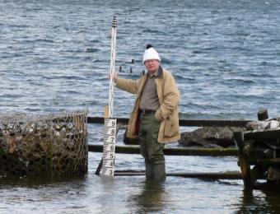
In Memoriam
David Pugh, UK
(† 1 August 2022)
Emeritus Fellow at the National Oceanography Center (NOC), UK.
Lead of UK delegation to the Intergovernmental Oceanographic Commission (IOC) Assemblies, and Chairman of IOC in 2003-2007.
Co-editor of the book “Troubled Waters”, to which SCOR contributed a chapter on non-governmental organizations.

Slide 10
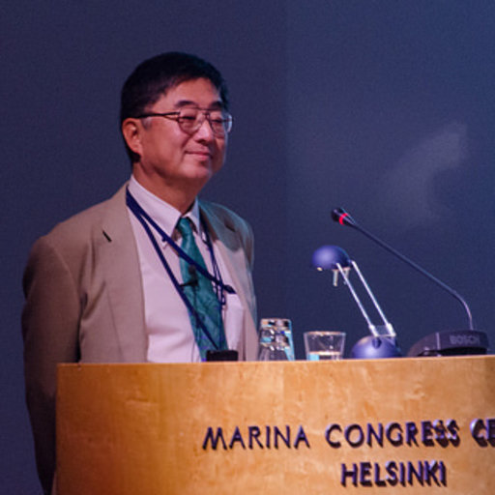
In Memoriam
Michio Aoyama, Japan
(† 5 September 2022)
Visiting Professor at the University of Tsukuba since 2019 and formerly Professor at the Institute of Environment Radioactivity at Fukushima University.
Full member of SCOR WG #146 on Radioactivity in the Ocean established in 2014.
Co-chair of SCOR WG #147 working on the comparability of global oceanic nutrient data (COMPONUT).
Member of the Scientific Steering Group of the International Carbon Coordination Project (IOCCP) from 2013 to 2018.

