Slide 1
Ocean sustainability under global change
for the benefit of society
Selected updates since Oct 2021 for SCOR 2022 Annual Meeting
www.imber.info | @imber_ipo | @IMBeR-IPO-China
International Project Office - China
State Key Laboratory of Estuarine and Coastal Research East China Normal University
Shanghai, China
imber@ecnu.edu.cn
imber.ecnu.edu.cn
International Project Office - Canada
Dalhousie University
Halifax, Nova Scotia
Canada
imber@dal.ca

Slide 2
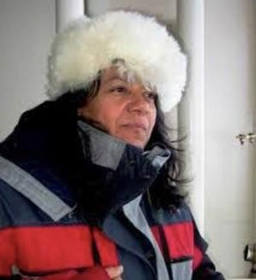
Dr. Diana Ruiz Pino
New Scientific Steering Committee Chair
Biogeochemist Oceanographer
Sorbonne Université - Laboratoire LOCEAN, Paris, France
Ocean carbon cycle, OMZ, acidification and climate change Times series, International Oceanographic cruises, Biogeochemical model, pH sensors, Ecosystem restauration
UN Decade of Ocean Sciences
COCAS Project 2021-2030
Marine Heat Waves Exemplar Co-design GOOS, 2022
Transdisciplinarity : Natural, Social Science, Artist, Civil Society, Governments and Business Networking, capacity building, transfer of knowledge Global South for a Global Ocean
See her intro video in French / English / Spanish on imber.info
Many thanks to the Former Chair Dr. Carol Robinson

Slide 3
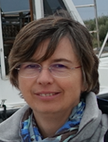
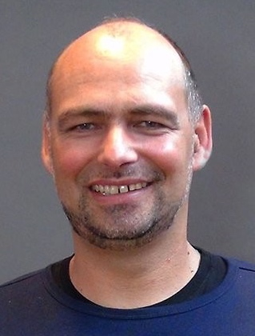
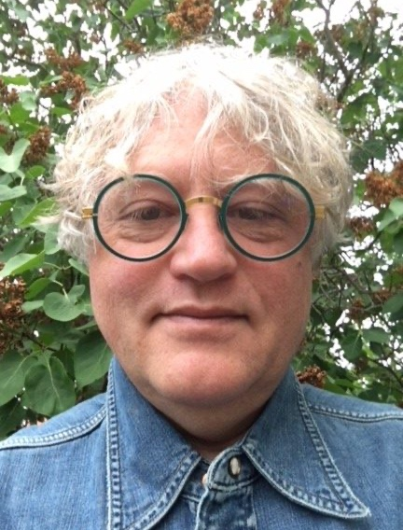
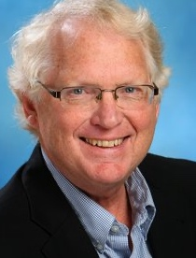
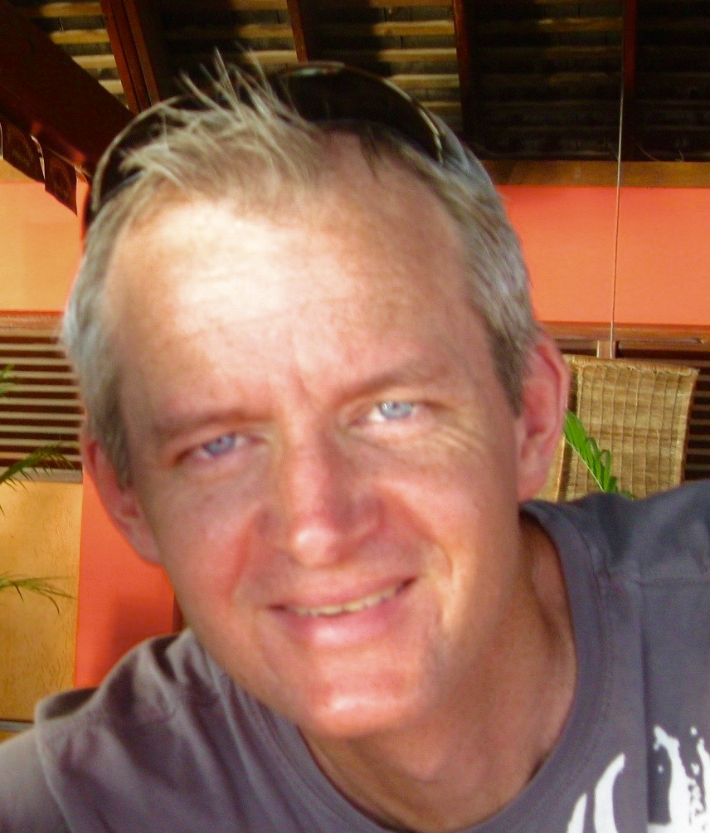
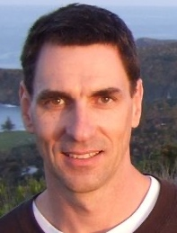
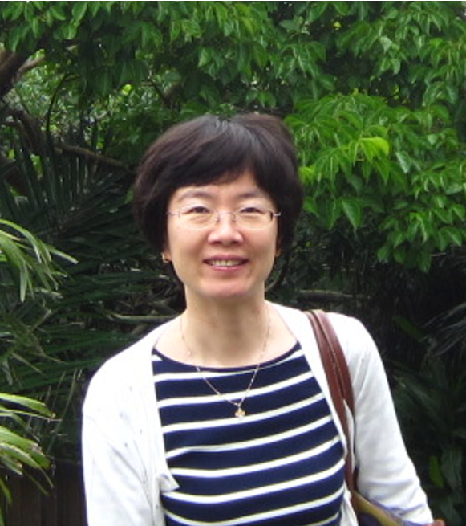
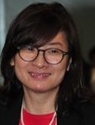
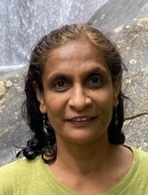
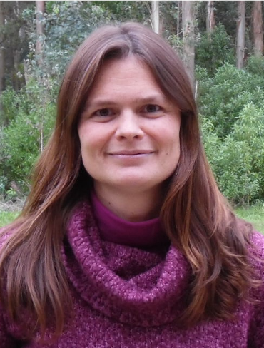
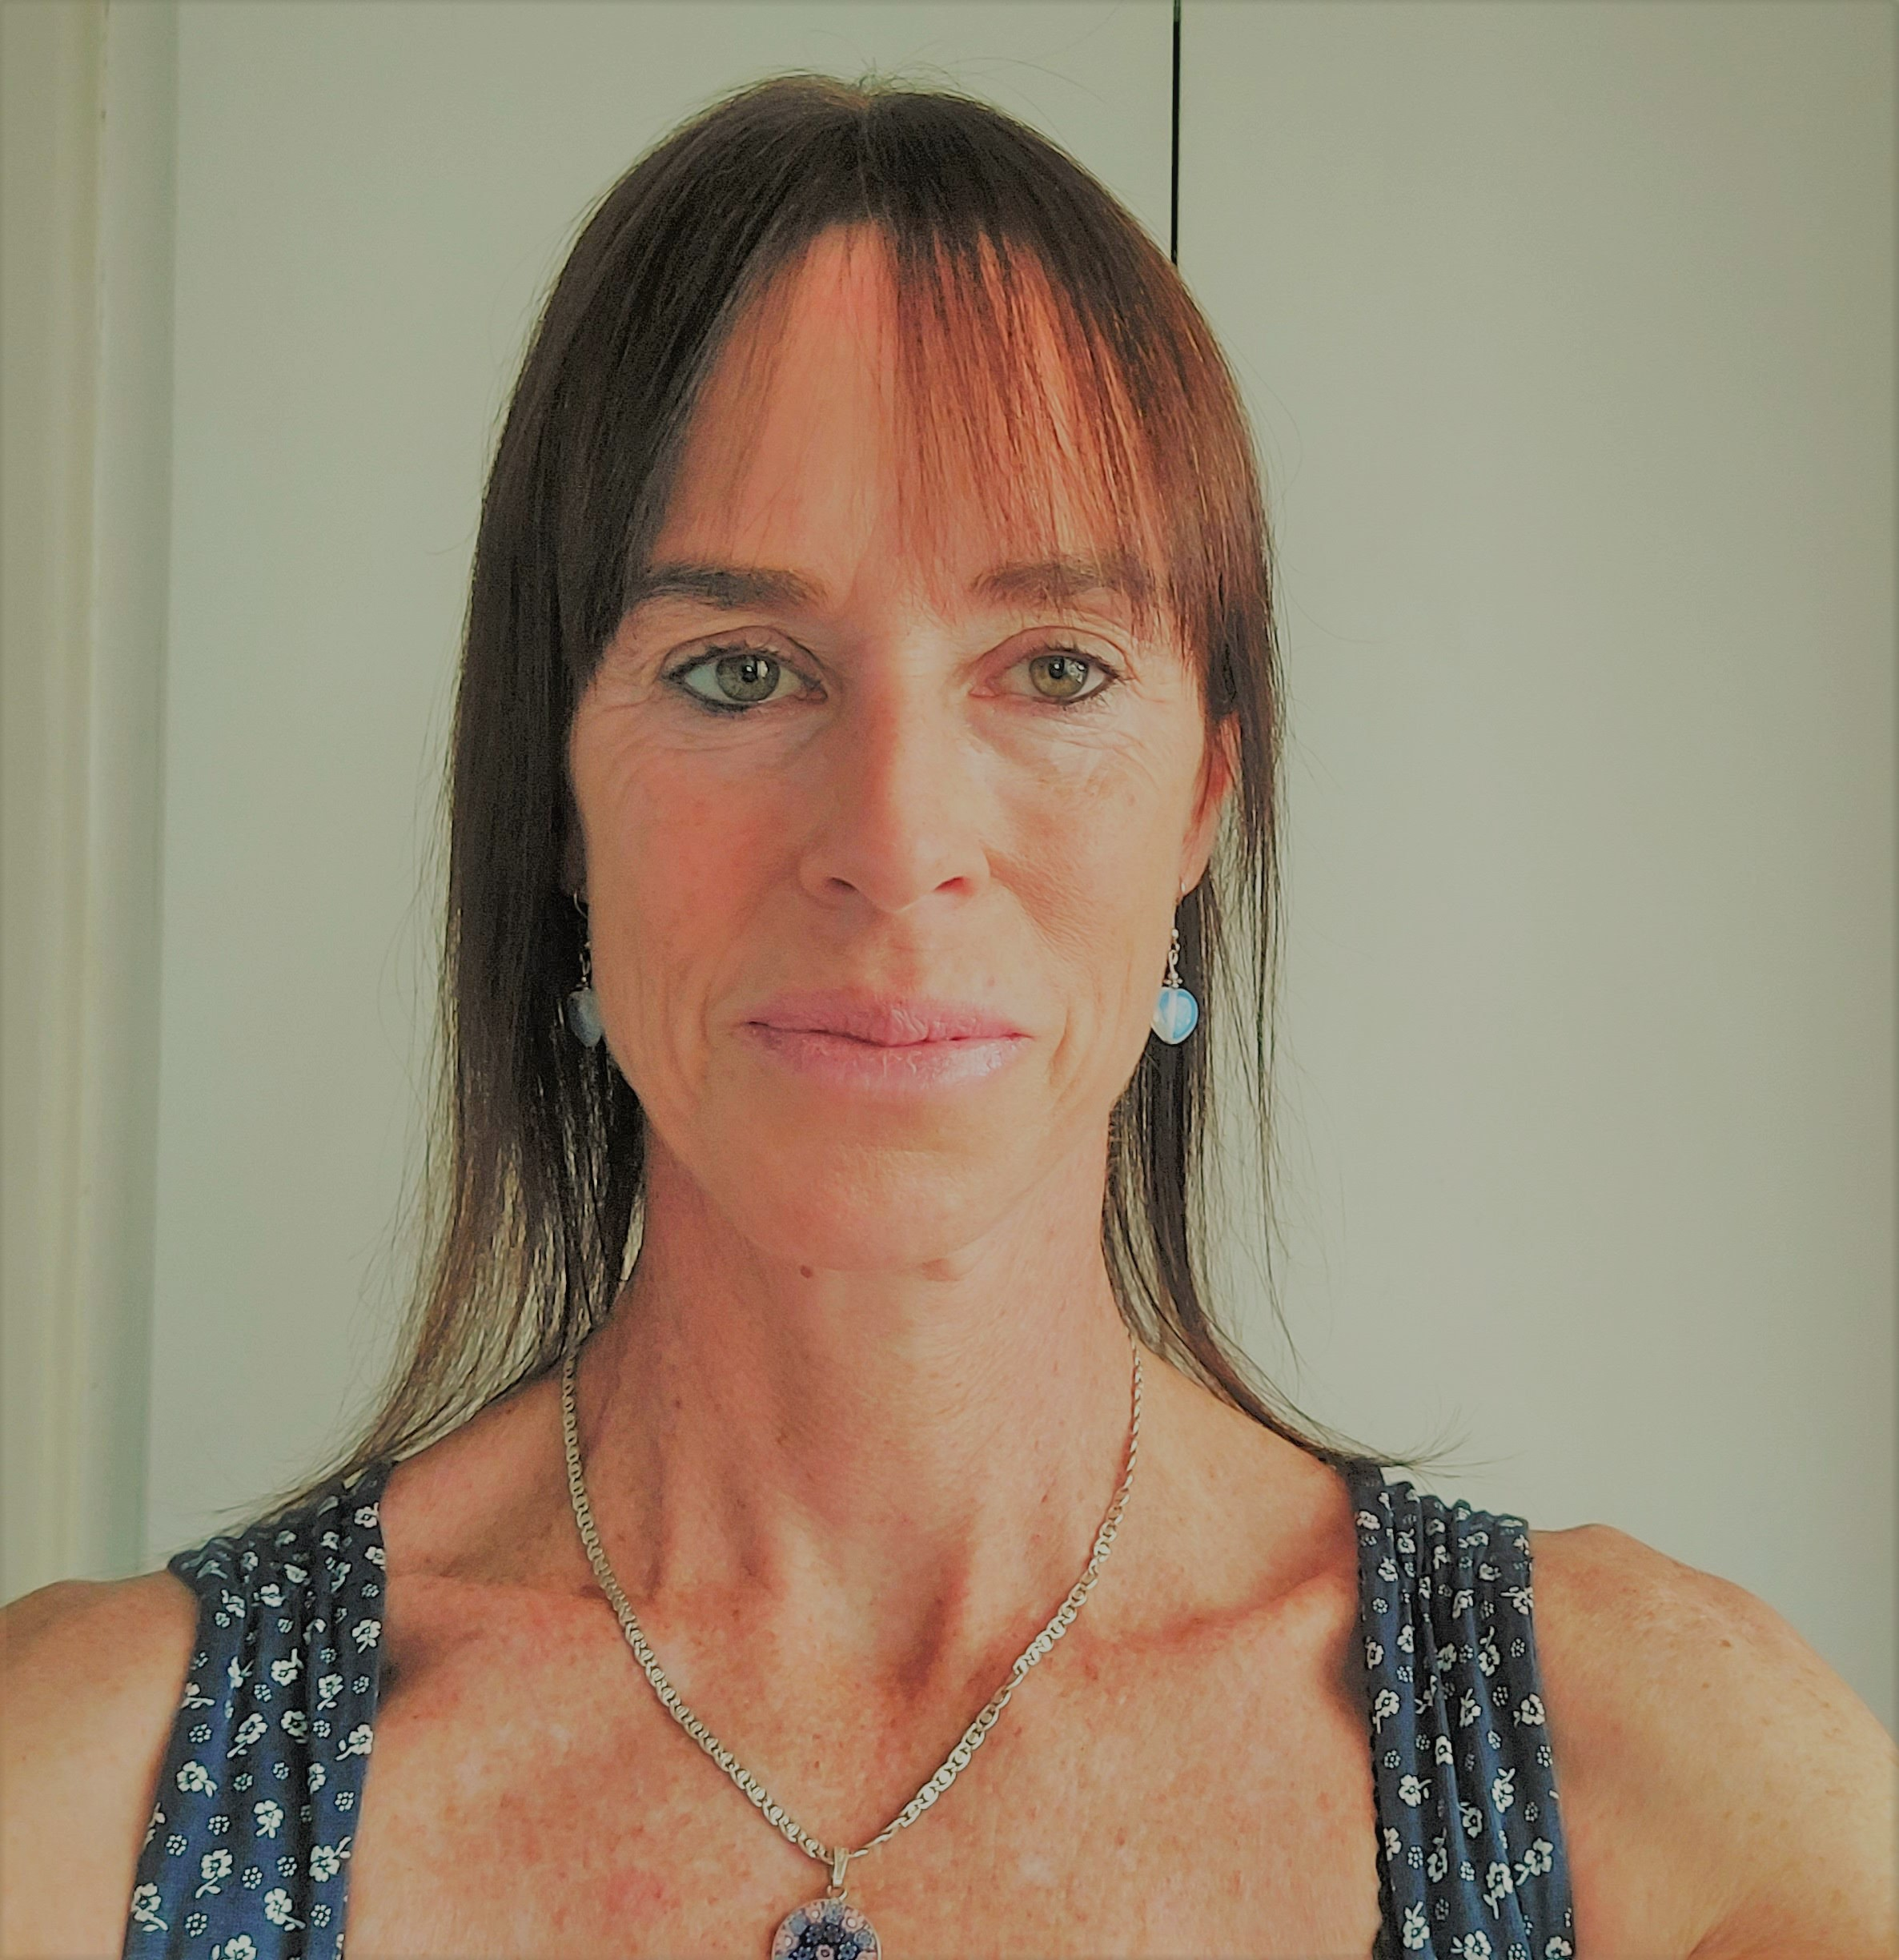
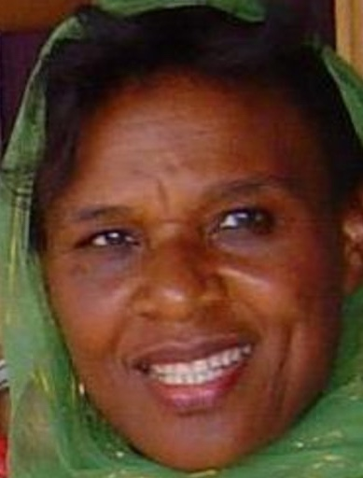
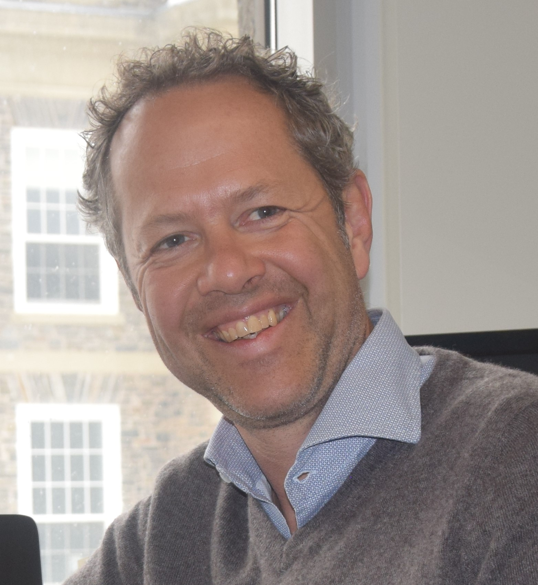
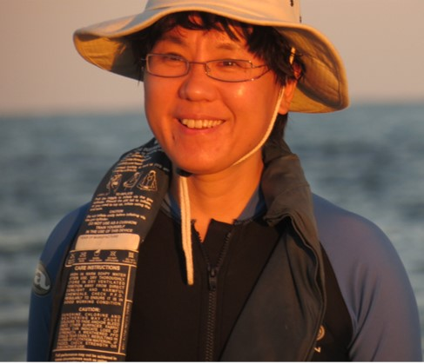
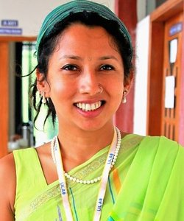
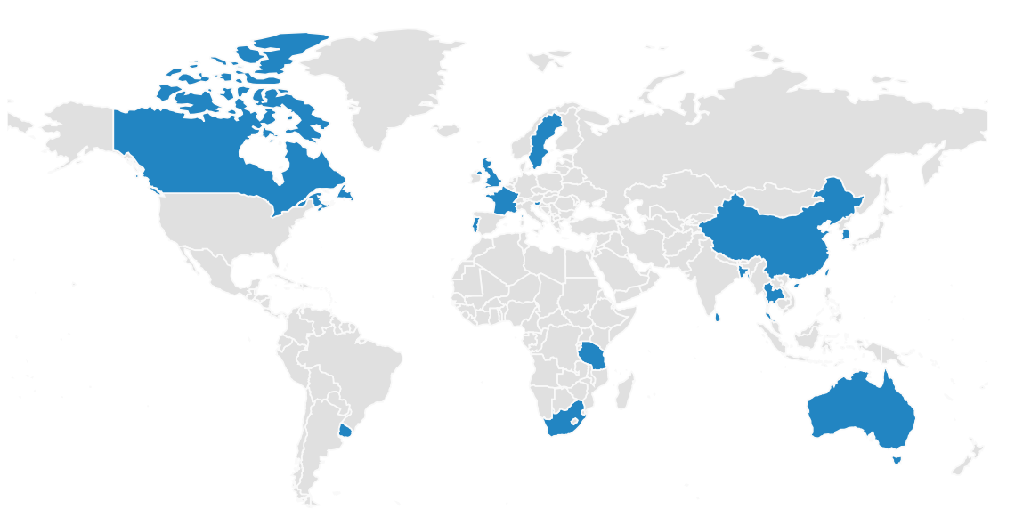
Scientific Steering Committee (SSC) 2022
Diana Ruiz Pino
Biogeochemist
Oceanographer
France
Marion Gehlen
Marine Biogeochemist
modelling
France
Alice
Newton
Social-
ecological
Portugal
Thorsten Blenckner
Social- ecological
Sweden
Andrea Belgrano
Macroecology Food webs
Sweden
Nina Bednaršek
Multiple stressors
Ocean Interventions
Slovenia
David
VanderZwaag
Law
Canada
Derek Armitage
Governance
Canada
Alistair
Hobday
Climate
adaptation
Australia
new
new
new
Jingling Ren
Biogeochemist
Oceanographer
China
Suvaluck
Satumanatpan
Fisheries
governance
Thailand
Nireka
Weeratunge
Socio-cultural
anthropology
Sri Lanka
Micaela Trimble
Social-
ecological
Uruguay
Lynne
Shannon
Ecological
modelling
South Africa
Narriman
Jiddawi
Socio-
economics
Tanzania
Boris
Worm
IPO-Canada host representative
Canada
Dongyan Liu
IPO-China host representative
China
Samiya
Selim
Early Career representative
Bangladesh
new
new
new
new
new
Ex-Officio SSC
Plus 12 ex-officio SSC members from Regional Programmes and Working Groups
16 SSC members from 13 countries across 6 continents

Slide 4
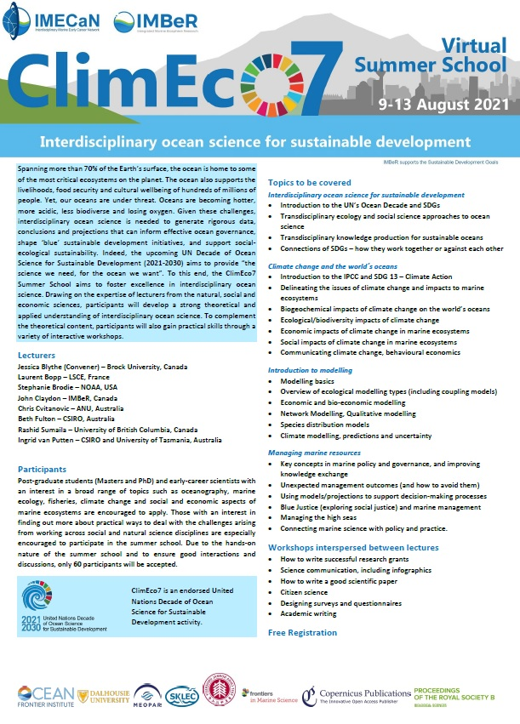
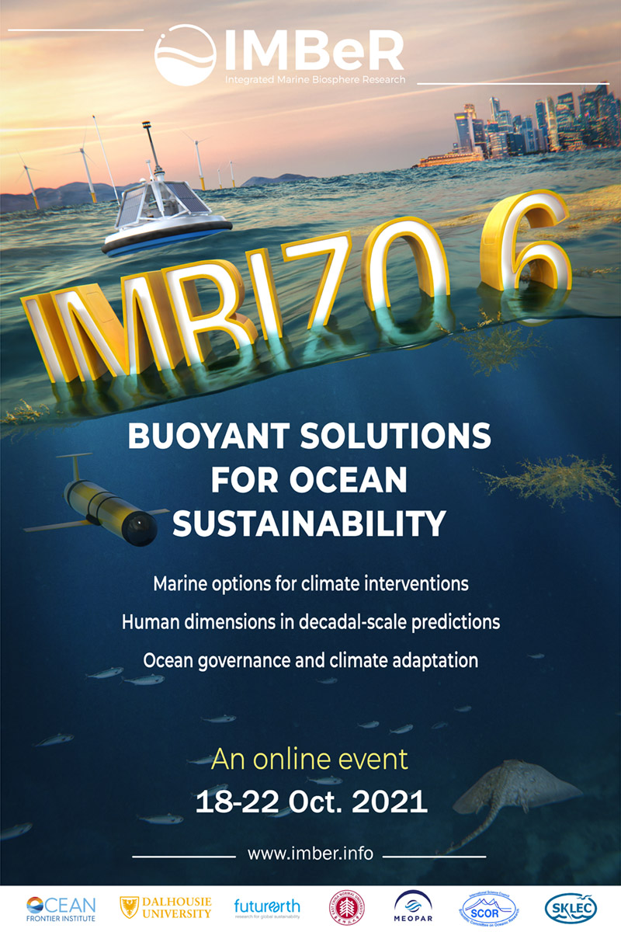
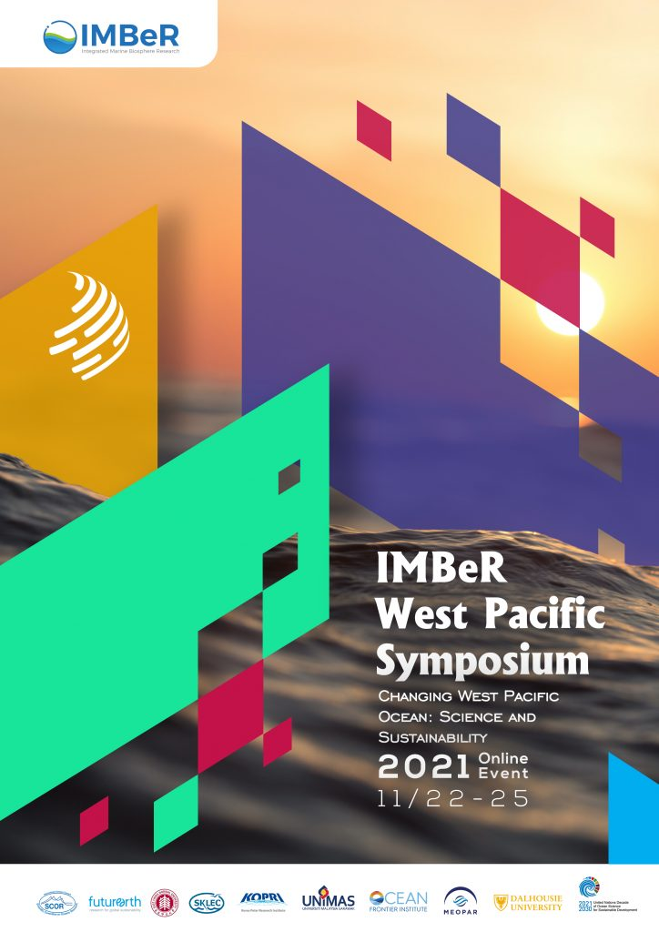
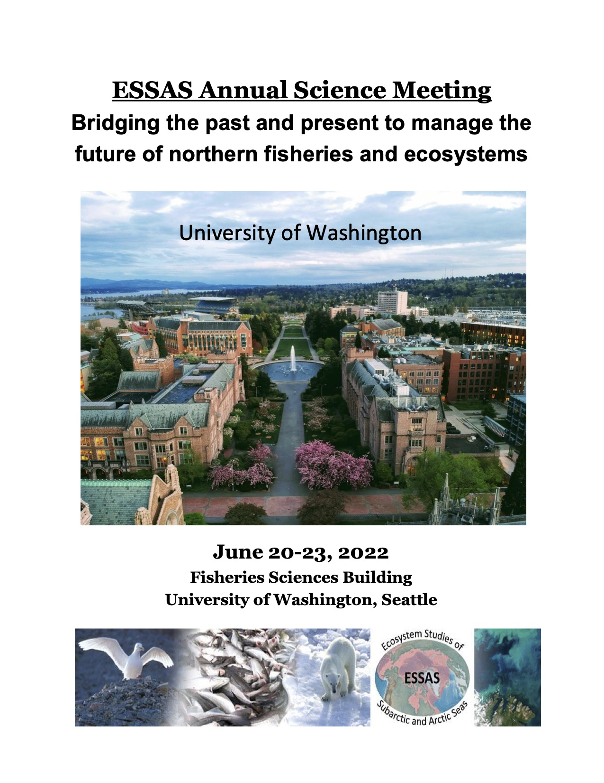
Major Events 2021-2022
IMBeR Summer School
Online, 2021
IMBeR Workshop
Online, 2021
West Pacific Symposium
Shanghai & Online, 2021
ESSAS Meeting
Seattle & Online, 2022

Slide 5
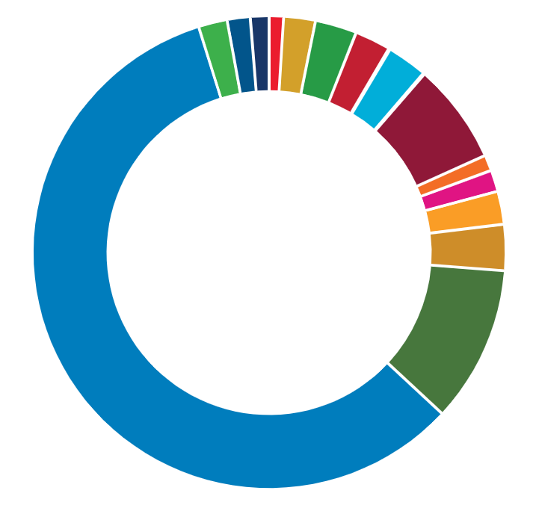
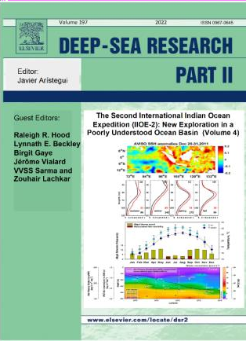
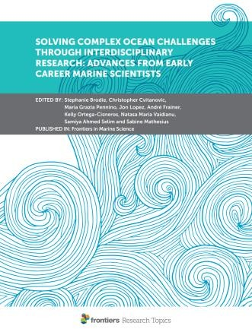
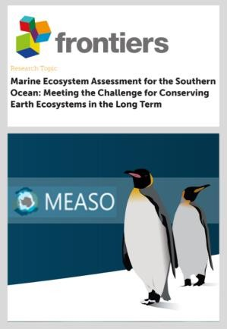
Publications
2021 – 2022
Rate over time
SDGs
12 - arising from IMBeR
84 - benefitted from IMBeR
Publications per year
IMBeR
Publications and the UN SDGs
200
150
100
50
0
2016 ‘17 ‘18 ‘19 ‘20 ‘21 ‘22
up to July only
8 - Policy relevant report
>70% contributes to SDG 14

Slide 6
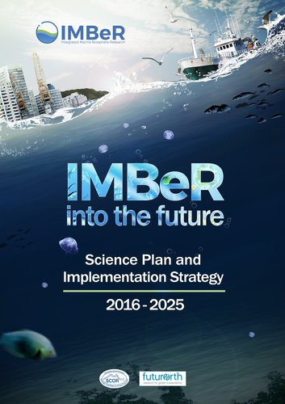
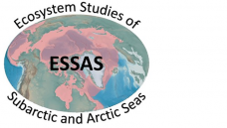
Implementation Strategy
Scientific Steering
Committee
International
Project Offices
Regional Programmes
+
Working Groups
Climate Impacts on Oceanic Top Predators
Continental Margins
Working Group
Future Earth Coasts
Ecosystem Studies of Sub-arctic and Arctic Seas
Working
Group
Integrating Climate and Ecosystem Dynamics
Integrated Ocean Carbon Research
IOC-IOCCP, WCRP/CLIVAR, SOLAS, GCP
Sustained Indian Ocean Biogeochemistry and Ecosystem Research
SOLAS-IMBeR Ocean Acidification
Science Plan & Implementation Strategy 2016-2025
Endorsed Projects
Synthesis Groups

Slide 7
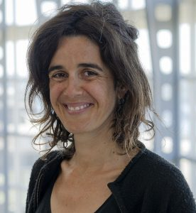
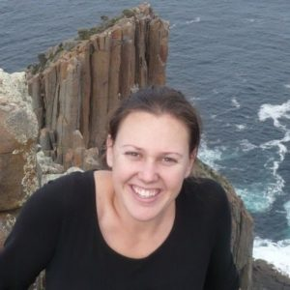
Ongoing Activities
Climate Impacts on Oceanic Top Predators (CLIOTOP)
Regional Programme
Anne Lorrain and Heidi Pethybridge
Operating since 2005, and now it is in the third phase (2016-2025).
Anne Lorrain
France
Heidi Pethybridge
Australia
Organise large-scale comparative efforts to elucidate key processes involved in the interaction between climate variability and change and human uses of the ocean on the structure of pelagic ecosystems and large marine species.
Seek to develop predictive capability for these socio-ecological systems and evaluate adaptation options to ensure future sustainability.
Call for cross-disciplinary task teams nominations
Provides seed funding ($1000 to $4000 USD): bringing task team members together, funding research projects, workshops and/or publication costs.
Proposal submission deadline: Friday 31st October 2022

Slide 8
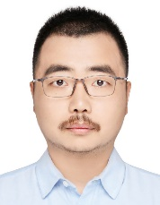
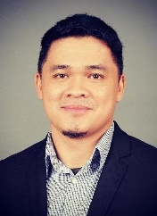
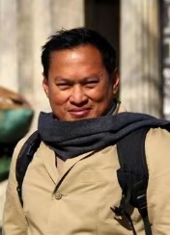
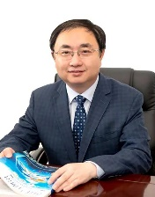
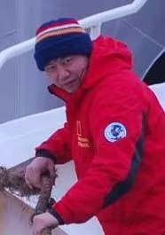
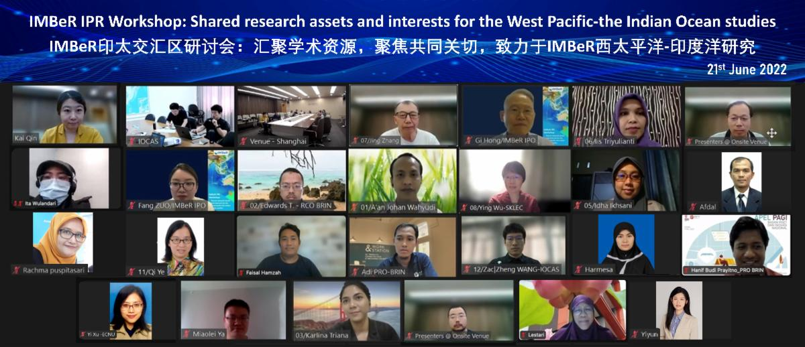
Indo-Pacific Region: marine biogeochemistry, biodiversity, sustainability (IMBeR IPR)
Synthesis Group
Shan Jiang, Aazani binti Mujahid, Deo Florence L. Onda, Romanus Edy Prabowo, Fan Wang and Jing Zhang
Set up in 2022, work program for 10 years
Shan Jiang
China
Aazani binti Mujahid
Malaysia
Deo Florence L. Onda
the Philippines
Objectives
Determine material fluxes in the sea areas between the Pacific and the Indian
Observe marine biodiversity in the sea areas
Understand the multi-spheres (Atmosphere-Hydrosphere-Biosphere-Lithosphere) interactions in terms of future climate changes
Contribution to the science based sustainable growth and protected areas management by using scientific research
Romanus Edy Prabowo
Indonesia
Fan Wang
China
Jing Zhang
China
IMBeR IPR Workshop: Shared research assets and interests for the West Pacific-the Indian Ocean studies
Online, 21 June 2022

Slide 9
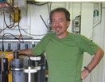
Post-Eutrophication
Synthesis Group
Dongyan Liu and Peter Thompson
Duration: 2022-2025, 18 members, 12 countries (six continents)
First online meeting in October/November 2022
Dongyan Liu
China
Peter Thompson
Australia
Contributes to
IMBeR Grand Challenge I
Understanding and quantifying the state and variability of marine ecosystems
The group wishes to provide scientifically robust solutions to the global community to remove any human-induced HABs which disturb the natural ecosystem greatly.
the existing knowledge on the nature of HABs and their impact on the adjacent marine ecosystems,
national or regional nutrient reduction policies,
the consequences of such policies on sites, and further wishes to
elucidate the relationship between nutrient reduction policies and climate-driven effects.

Slide 10
Future Plans
Ocean Color based Plant species identification and Carbon flux in the Indo-Pacific oceans (OCPC)
Synthesis Group
Young-Je Park and Fang Shen
Set up in 2022, work program for 10 years, 10 members, five countries (Korea, China, Japan, UK and US)
Young-Je Park
Korea
Fang Shen
China
Work Program (2022-2032):
Develop algorithms to quantify carbon fluxes mediated by marine biosphere
Synthesis for the East Indian and the West Pacific Ocean
Training session – one session a year
Submitted a proposal for ESA-Future Earth Joint Program September 2022
www.imber.info or IMBeR OC-PC Study Group (no login needed)
Notes:
https://imber.info/science/focus-study-groups/

Slide 11
Capacity Development
and Training
Young Scholar (IYS) Program 2022-2025: Applications Open
Networking mentors-mentees for mentee initiative research completion to assist conception of scientific ideas to publication.
10 mentees and mentors from the established laboratories
Mentors may host selected mentees in their laboratories
Training Course on Coatal Blue Carbon Accounting
To assist countries to include coastal blue carbon in their national greenhouse gas inventories to meet the purposes of UNFCCC 1992 and Paris Agreement 2015
IPO-China, State Key Laboratory of Estuarine and Coastal Research and Institute of Eco-Chongming, ECNU
Submitted proposals to NSFC (April 2022) and to SDGs Collaborative Funding program (August 2022)

Slide 12
Integrated Marine Biosphere Research
Thank you SCOR
www.imber.info | @imber_ipo | @IMBeR-IPO-China

