Slide 1
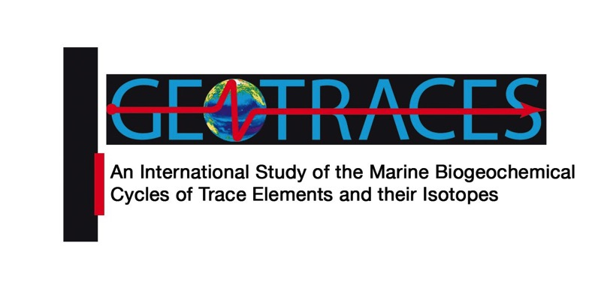
Co-chairs: Karen Casciotti, Stanford University Maeve Lohan, Souhtampton University

Slide 2
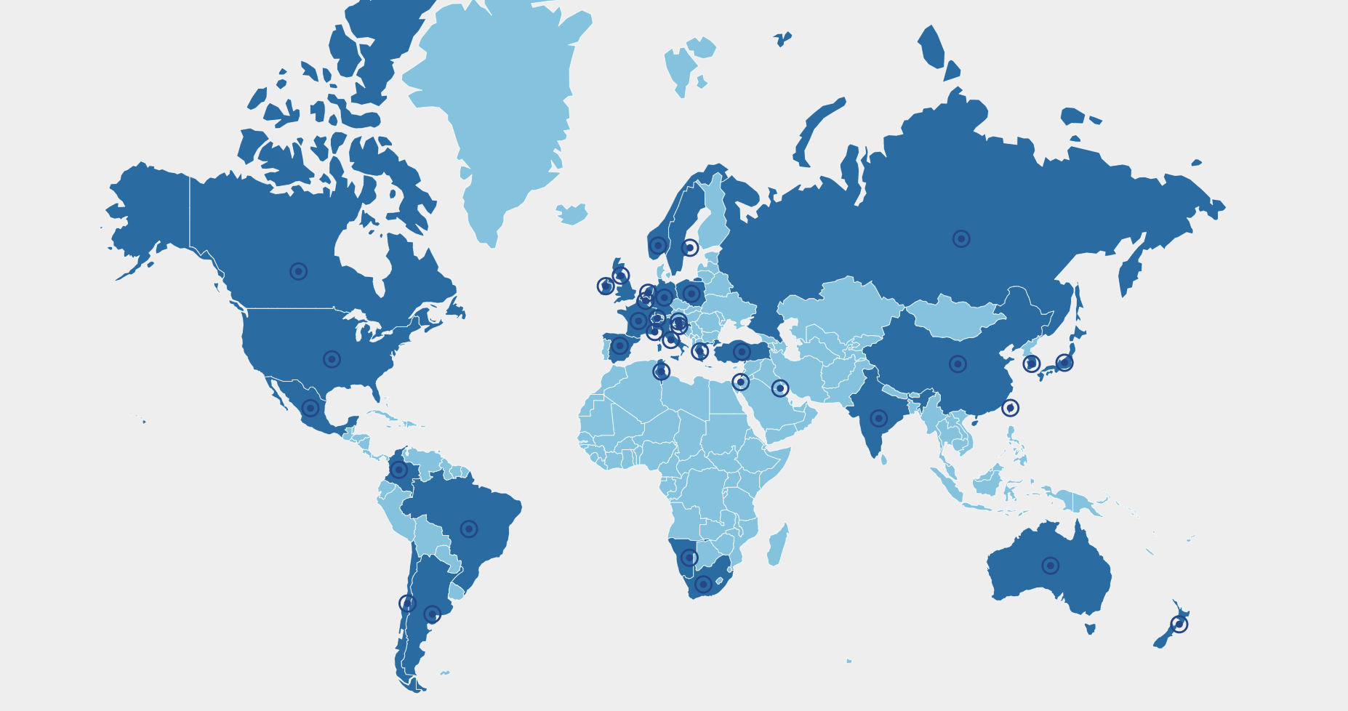
GEOTRACES mission
GEOTRACES mission is to identify processes and quantify fluxes that control the distributions of key trace elements and isotopes (TEIs) in the ocean, and to establish the sensitivity of these distributions to changing environmental conditions
To date:
36 Countries
132 cruises completed 2,140 publications 30 Scientific Workshops
Data Products in 2014, 2017 and 2021 Synthesis Workshops in 2015, 2016, and 2018
To accomplish this mission GEOTRACES plans to complete 5 more section cruises and several process studies; next intermediate data product for 2025; next synthesis workshop planned for 2024; and envision what products can be released with the final one.

Slide 3
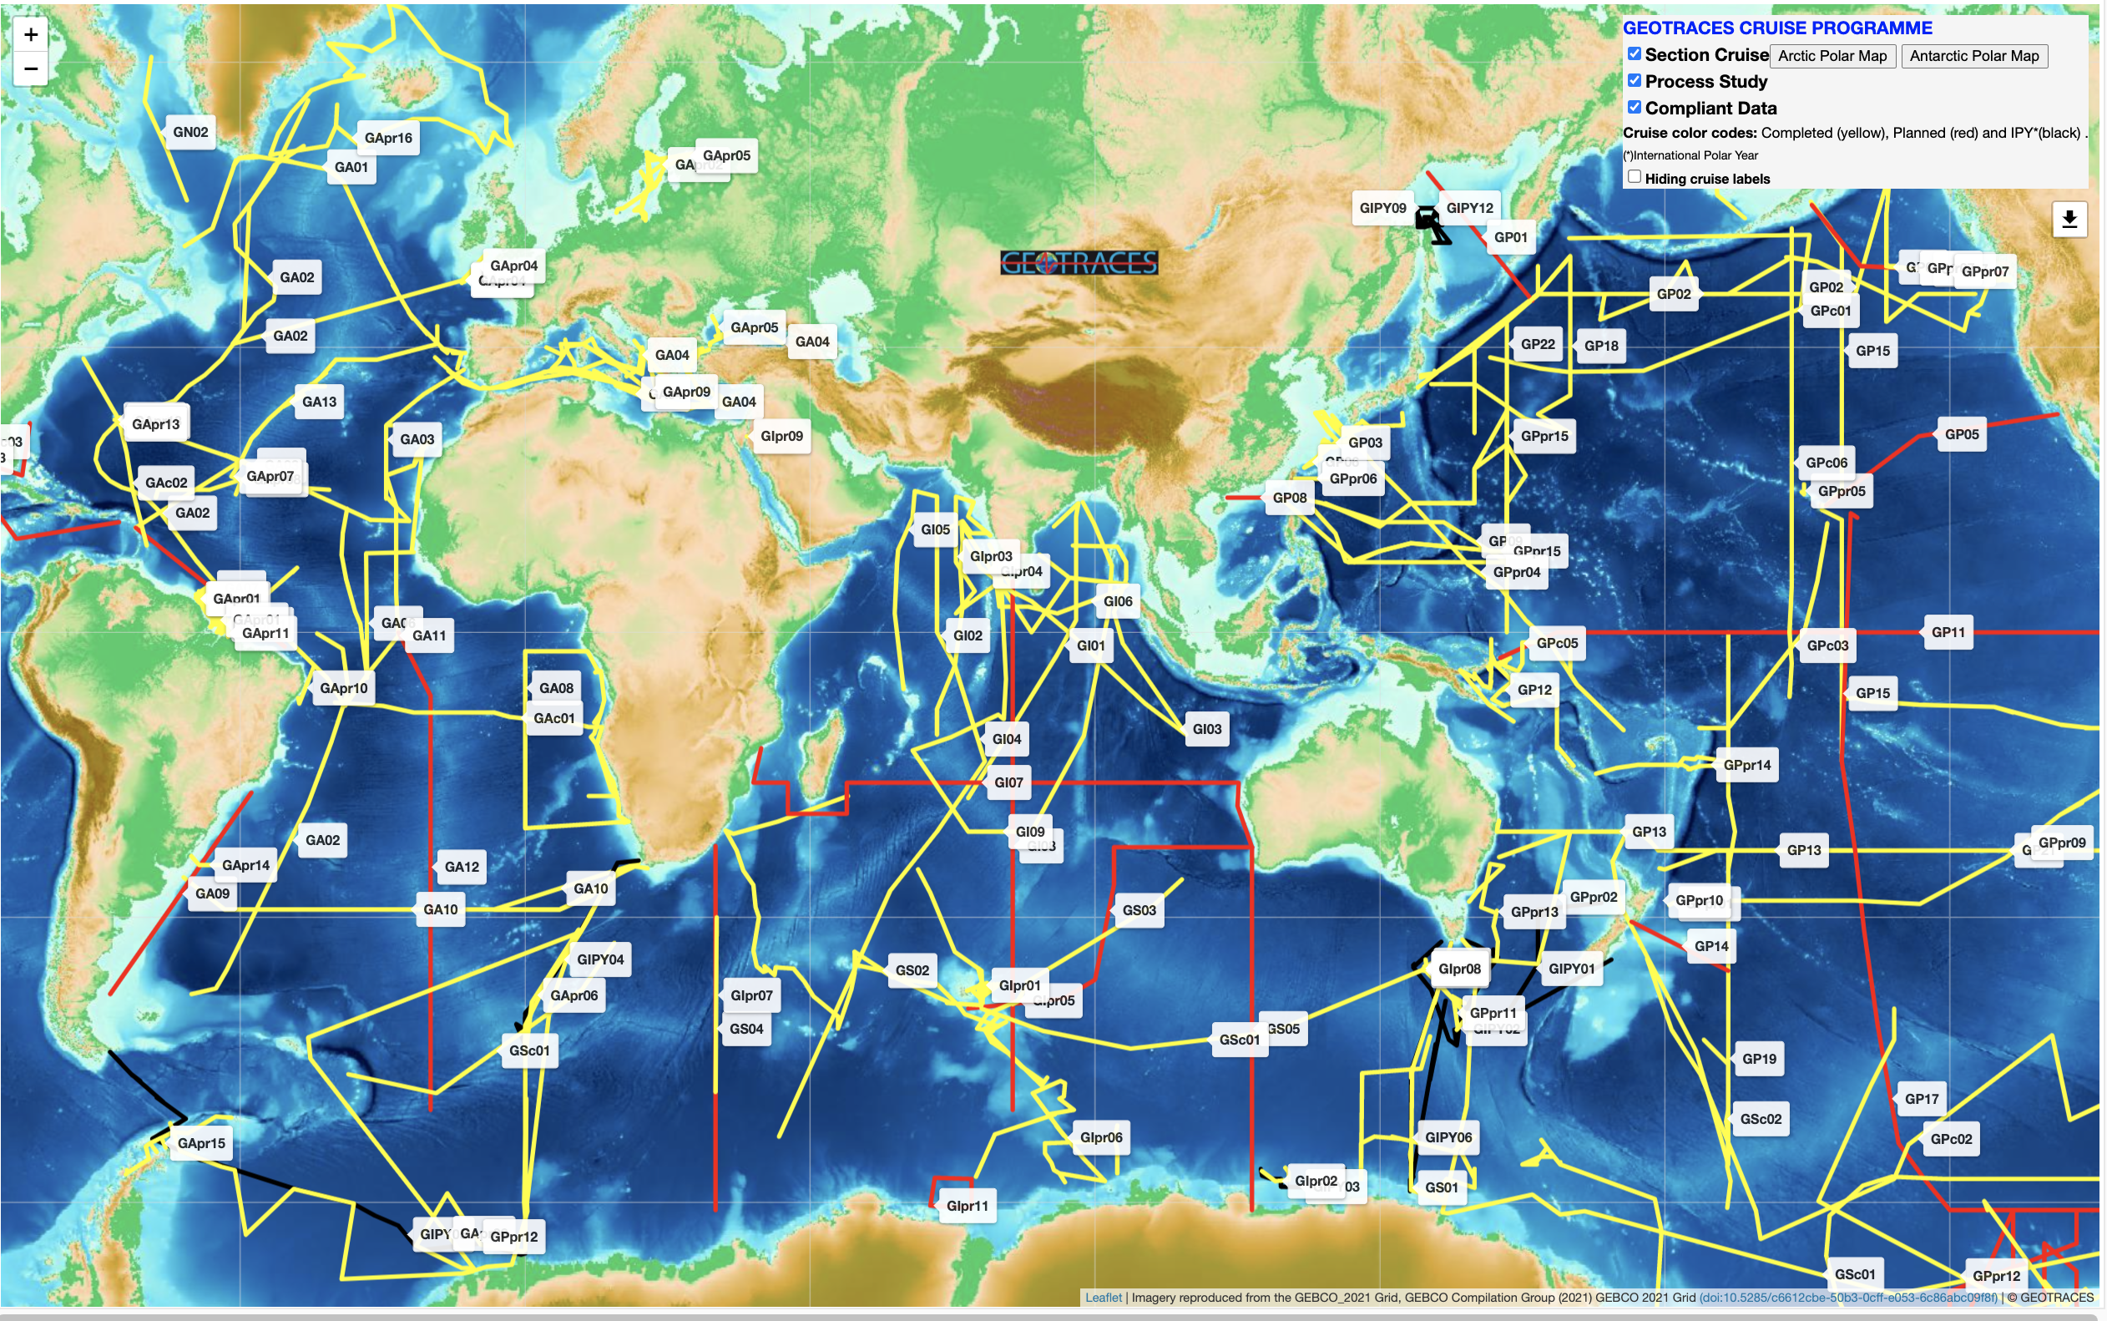
Ocean Implementation Plans
Global GEOTRACES Cruise Section Map: https://www.bodc.ac.uk/geotraces/cruises/section_maps/interactive_map/
Notes:
OSM 2020 Session: "Linking the Biology, Geochemistry, and Circulation of the Gulf of Mexico”, Co-chairs: Alan Shiller, Angela Knapp, Heather Benway, Juan Carlos Herguera. >50 abstracts; 2 papers in press.

Slide 4
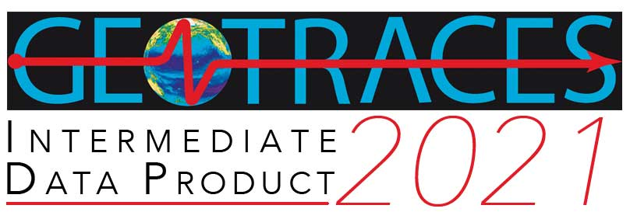
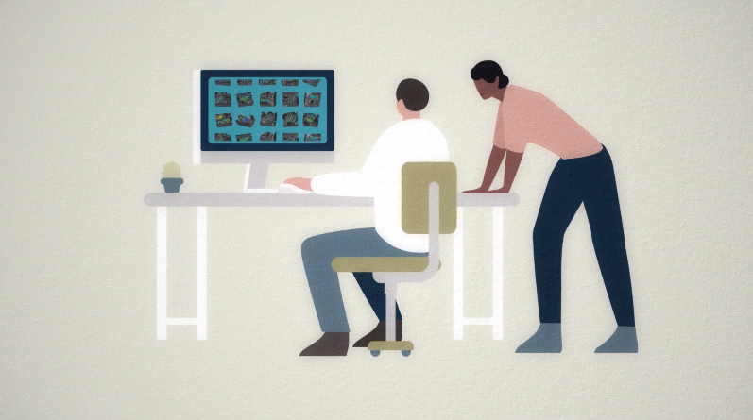
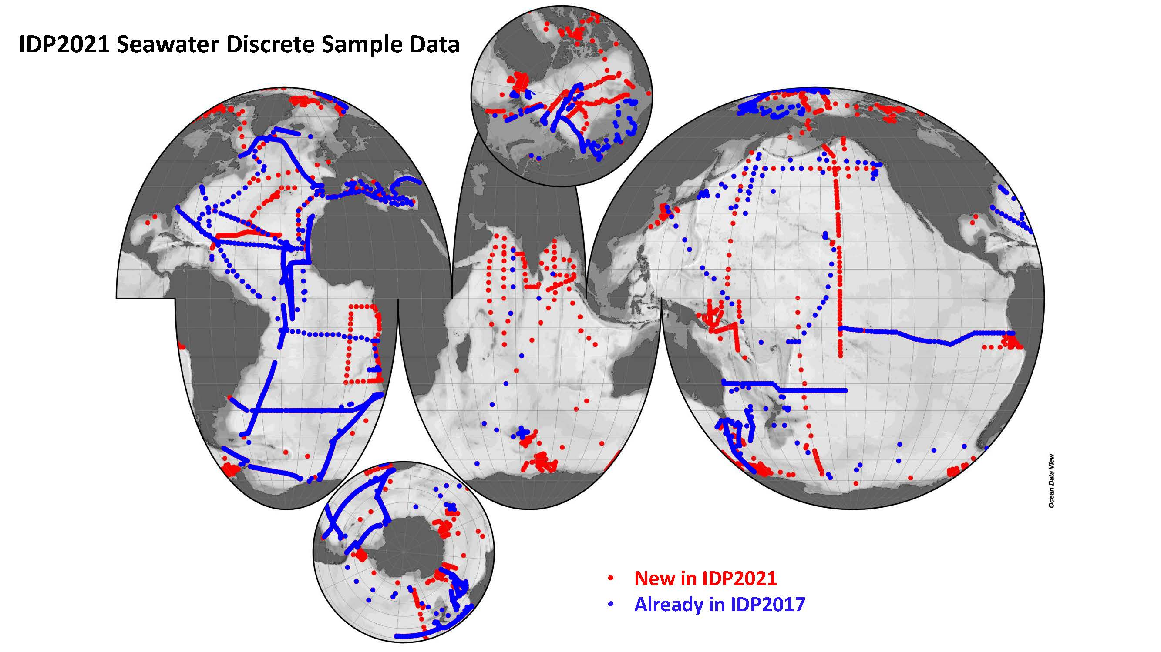
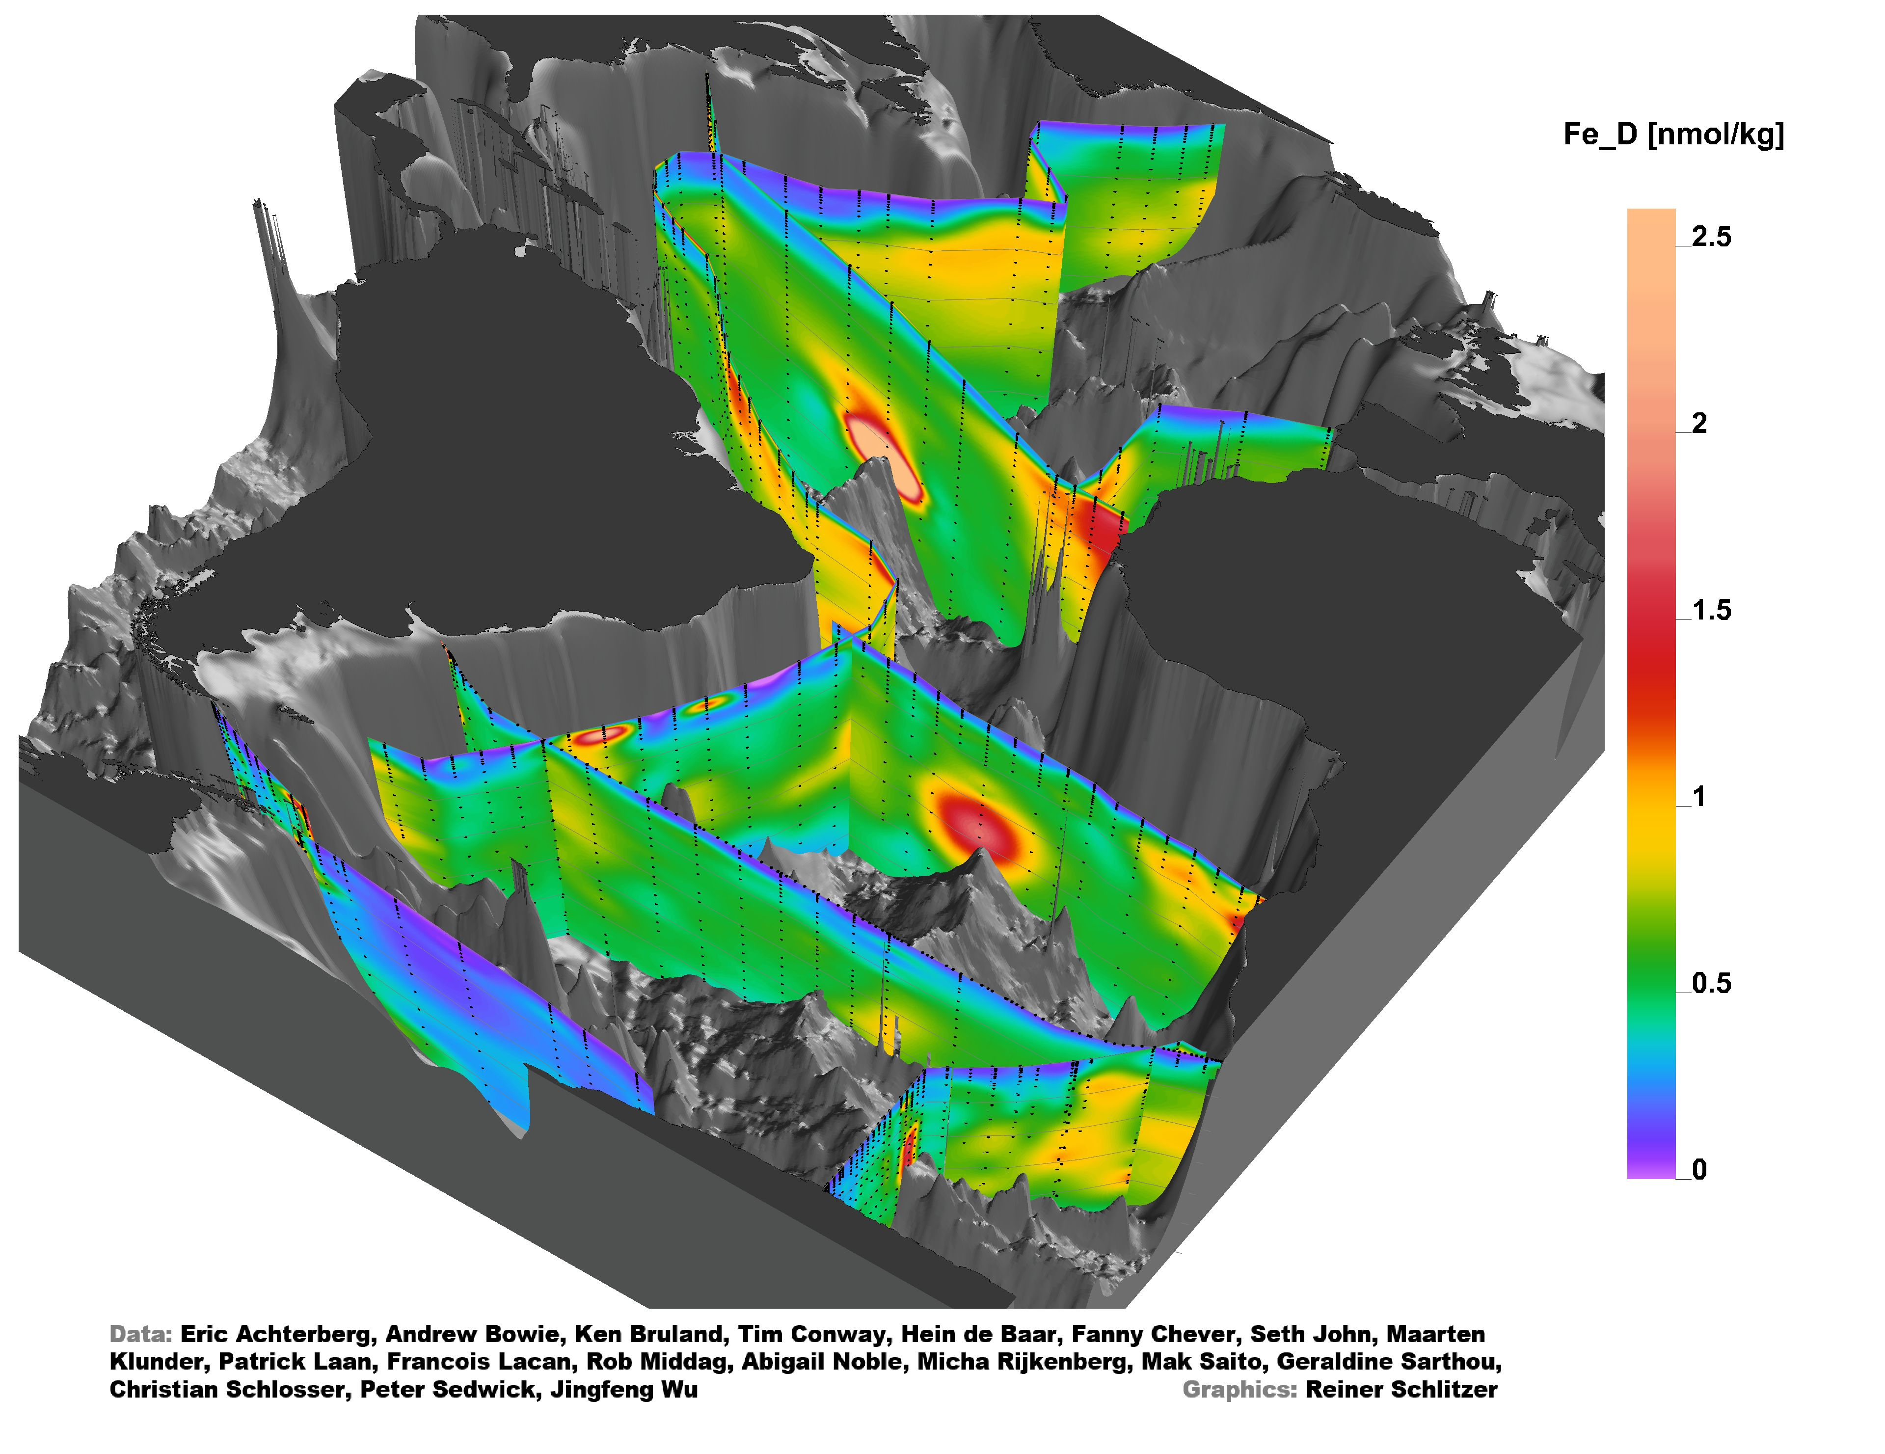
GEOTRACES Intermediate Data Product
New GEOTRACES Intermediate Data Product, IDP2021!
www.bodc.ac.uk/geotraces/data/dp
IDP2021 consists of:
(1) a compilation of digital trace metal data 100,000 samples from 77 cruises (geotraces.org/dp) | (2) the eGEOTRACES Electronic Atlas (egeotraces.org)
Freely available on-line! Thanks to 350 contributors!

Slide 5
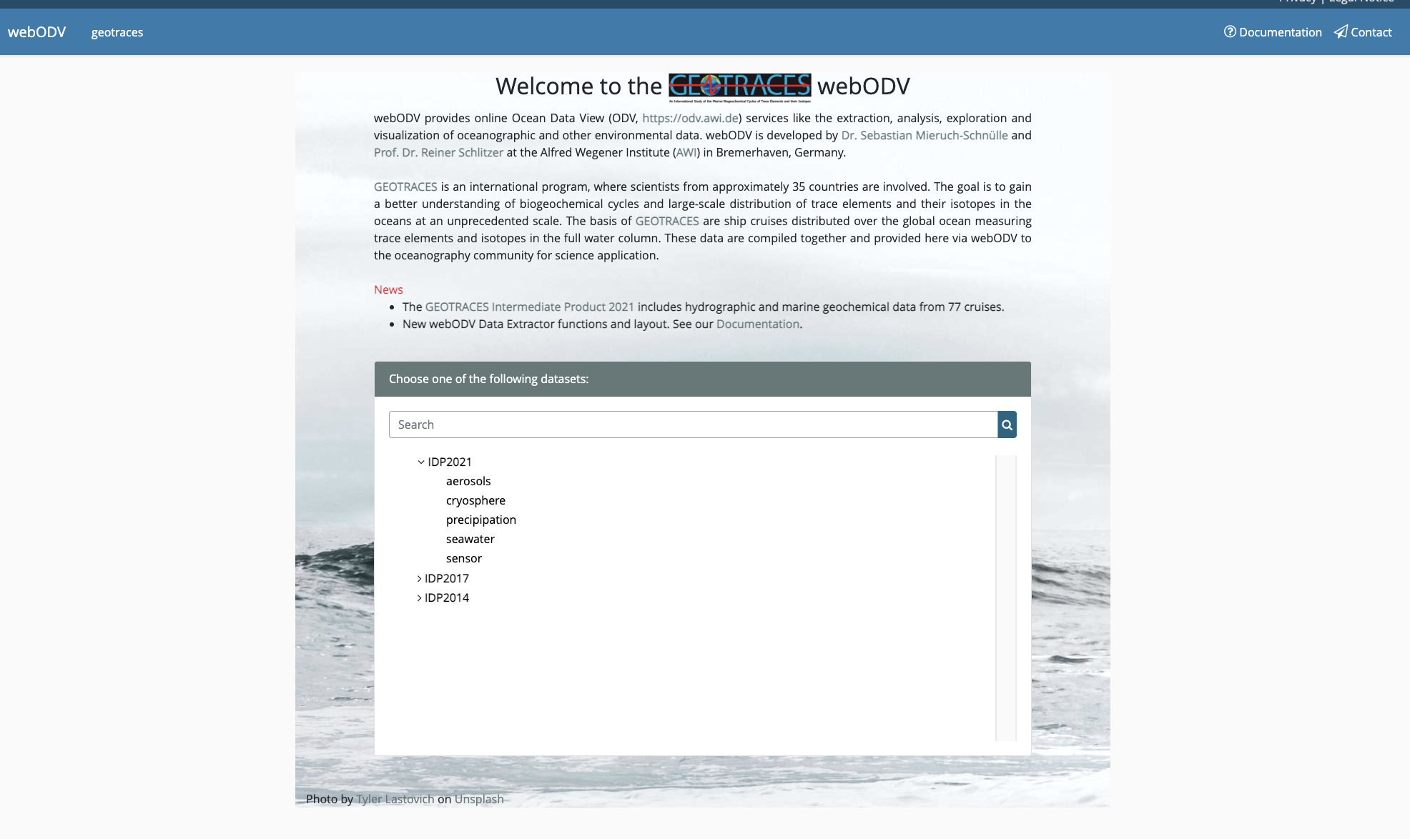
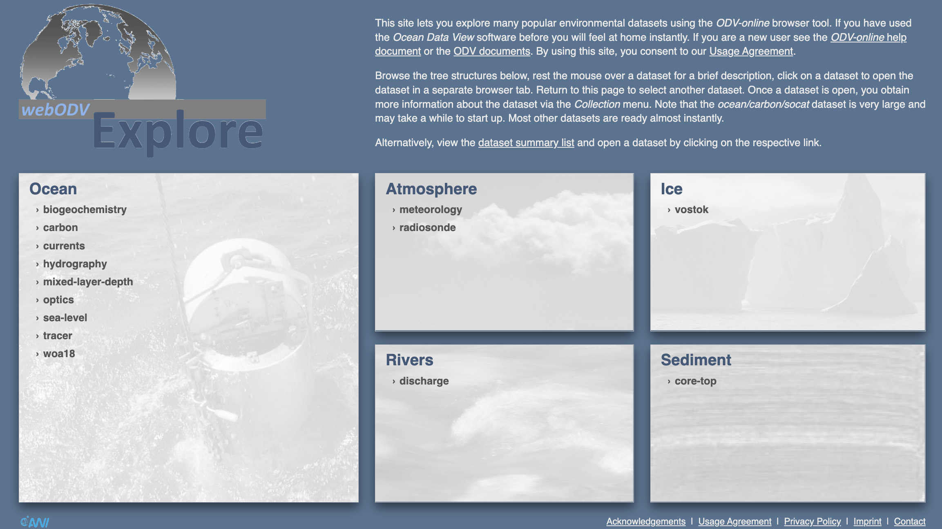
GEOTRACES Intermediate Data Product
By releasing and sharing more high-quality hydrographic and marine geochemical data from 77 cruises, we wish to strengthen and intensify the collaboration within the marine geochemical community itself, but also invite colleagues from other communities to join us.
Subset extraction with web ODV Extractor tool (https://geotraces.webodv.awi.de/)
Analysis, exploration and visualisation without download with web ODV Explore tool (https://geotraces.webodv.awi.de/)
Tutorials:
*What does IDP2021 include and how can be accessed? https://youtu.be/j3mjfh-RSjU
*Working with IDP2021 and webODV Explore tool: https://youtu.be/y5WqlrjU1bs
*Linking trace metal and isotope TEI and genomics data with webODV: https://youtu.be/ON1PKvHQNlA

Slide 6
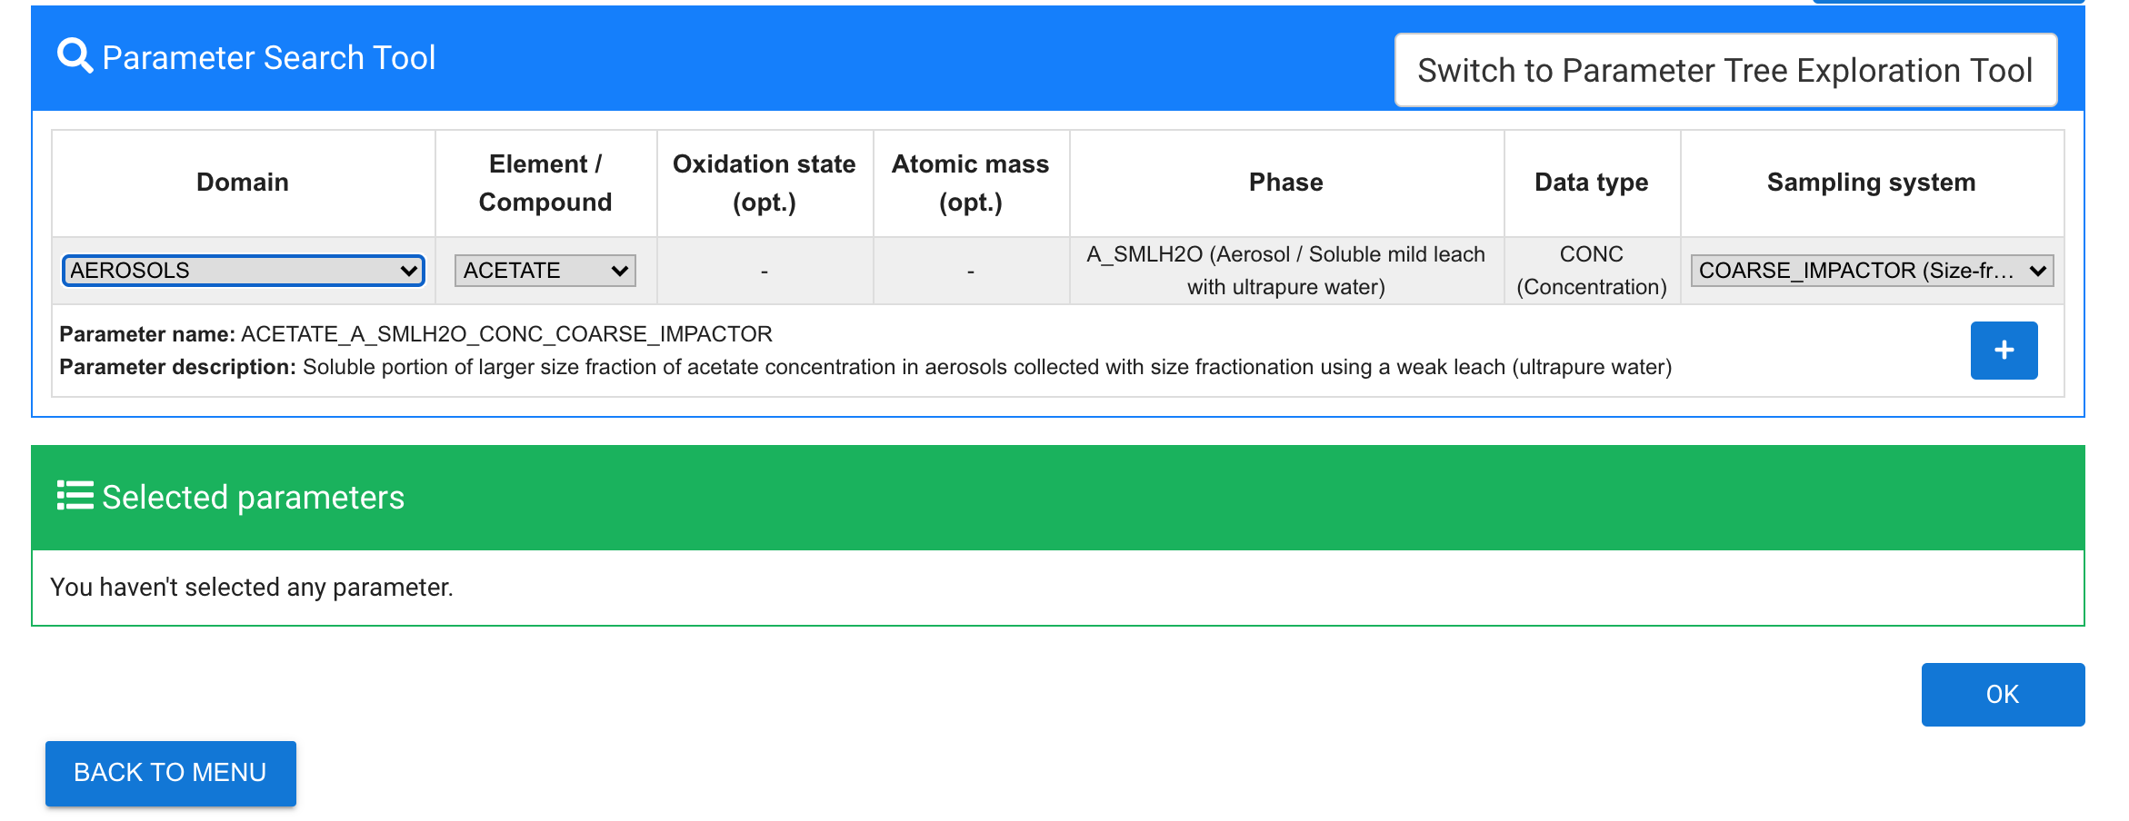
GEOTRACES Data for Oceanic Research (DOoR)
Dedicated on-line portal to register data sets for intercalibration and potential inclusion in IDP, generate templates for data submission and provide necessary metadata for the building of the IDP
Management tool for GEOTRACES subcommittees and the GEOTRACES Data Centre to work on the preparation of the IDP
Sharing the knowledge and code for use by other groups (open access)
https://geotraces-portal.sedoo.fr/pi/

Slide 7
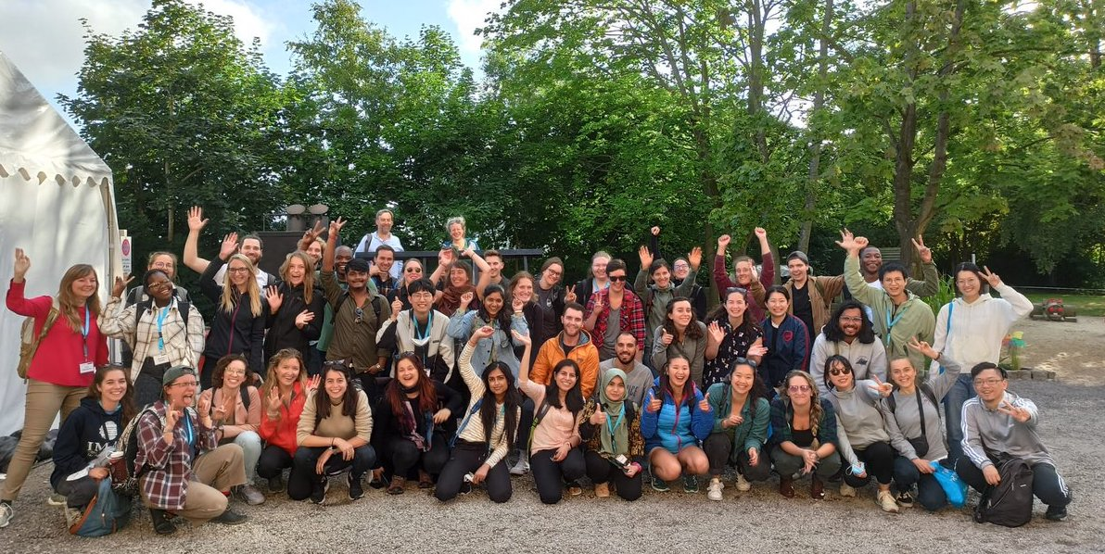
Summer School
Third International GEOTRACES Summer School: Introducing Polar Parameters
10 – 15 July 2022 in Bremerhaven, Germany Organisers: Walter Geibert (AWI), POLMAR Graduate School @AWI (Claudia Hanfland)
48 students (16 countries) and 17 lecturers Thanks SCOR for Travel support (Capacity Grant)
Contact GEOTRACES:
International Coordination:
GEOTRACES International Project Office (LEGOS-OMP, Toulouse, France)
Catherine Jeandel (Scientific Director)
Elena Masferrer Dodas (Executive Officer) ipo@geotraces.org
Data Management:
Donna Cockwell (Data Manager)
GEOTRACES Data Assembly Centre (BODC, Liverpool) geotraces.dac@bodc.ac.uk
Subscribe to our eNewsletter and mailing list!
www.geotraces.org

Slide 8
https://youtu.be/nW67w-efmm8

